Slide 3
Vison Transformer (without Data augmentation)(no.1)
Augmentierung: Spiegeln, Crop with padding n = 4

Slide 4
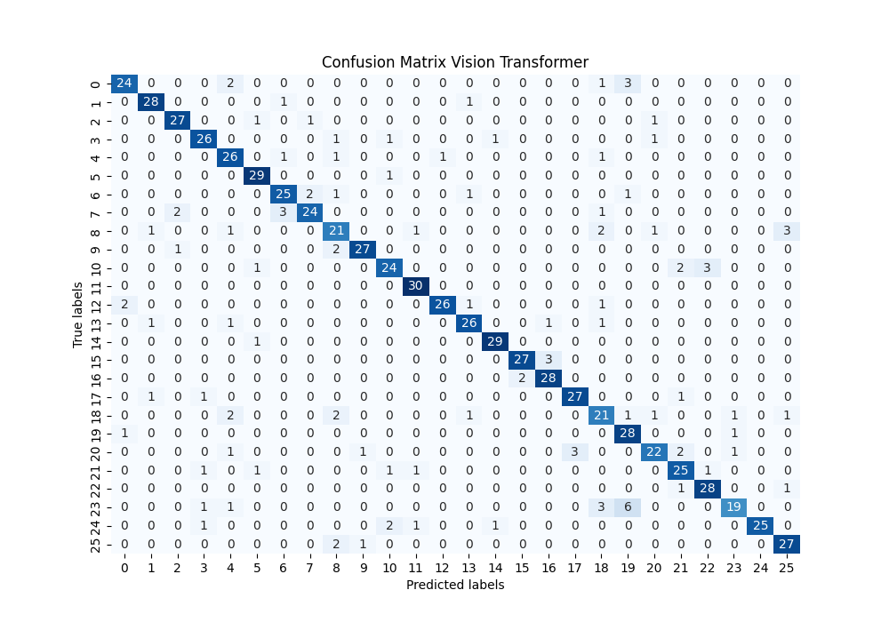
Vision Transformer (no.1) – Confusion Matrix

Slide 5
Vision Transformer (no.1) – Labels
Labels Testdaten:
[12, 2, 4, 1, 22, 24, 8, 5, 22, 16, 10, 6, 16, 21, 9, 1, 13, 0, 21, 0, 15, 0, 25, 24, 17, 1, 4, 14, 10, 10, 5, 23, 25, 15, 5, 12, 7, 1, 13, 8, 7, 2, 21, 2, 22, 2, 15, 18, 15, 1, 9, 1, 6, 7, 6, 17, 2, 7, 11, 21, 18, 0, 18, 6, 13, 0, 1, 2, 10, 1, 25, 22, 16, 13, 3, 23, 10, 5, 20, 15, 6, 25, 14, 15, 2, 3, 5, 6, 10, 18, 8, 3, 22, 2, 3, 10, 9, 8, 25, 5, 4, 8, 11, 1, 18, 25, 11, 22, 4, 14, 8, 17, 8, 21, 19, 0, 12, 0, 1, 3, 2, 15, 3, 3, 14, 13, 15, 25, 6, 21, 16, 4, 19, 22,
22, 2, 23, 21, 19, 4, 12, 12, 7, 24, 16, 11, 16, 5, 7, 6, 0, 11, 17, 5, 0, 14, 21, 22, 22, 25, 19, 11, 24, 21, 24, 10, 16, 4, 6, 22, 18, 1, 1, 9, 20, 11, 8, 25, 19, 24, 7, 10, 16, 5, 23, 17, 3, 22, 10, 15, 17, 24, 0, 17, 2, 18, 12, 20, 18, 9, 1, 18, 6, 3, 4, 6, 5, 10, 16, 4, 24, 7, 9, 17, 20, 4, 19, 25, 23, 1, 1, 25, 18, 12, 0, 12, 25, 12, 21, 3, 5, 20, 24, 13, 25, 13, 25, 14, 17, 6, 7, 9, 13, 25, 5, 23, 18, 16, 1, 16, 11, 0, 25, 3, 18, 7, 6, 11, 0, 7, 9, 22, 14, 12, 23, 12, 23, 7, 10, 0, 23, 6, 22, 12, 4, 7, 22, 9, 14, 8, 3, 2, 16, 25, 7, 13, 17, 24, 12, 2, 13, 23, 8, 6, 5, 23, 21, 9, 18, 8, 8, 24, 4, 2, 23, 8, 21, 22, 0, 19, 16, 20, 9, 24, 20, 13, 5, 12, 21, 13, 19, 24, 21, 0, 18, 17, 12, 5, 22, 15, 11, 0, 25, 21, 6, 23, 20, 9, 21, 24, 19, 11, 11, 14, 2, 23, 13, 10, 20, 16, 7, 10, 0, 20, 12, 1, 12, 2, 20, 25, 2, 4, 20, 8, 23, 19, 21, 9, 19, 8, 25, 12, 11, 13, 1, 20, 0, 5, 22, 11, 11, 7, 2, 13, 17, 23, 2, 14, 10, 12, 17, 24, 9, 14, 8, 10, 25, 24, 23, 7, 18, 14, 1,
4, 12, 10, 20, 23, 18, 22, 11, 8, 19, 4, 15, 3, 1, 7, 13, 22, 13, 18, 8, 3, 23, 17, 19, 10, 16, 5, 25, 18, 24, 11, 17, 15, 13, 9, 14, 14, 9, 19, 4, 2, 16, 9, 18, 0, 25, 3, 1, 20, 10, 25, 22, 21, 14, 7, 24, 21, 6, 10, 23, 2, 6, 15, 3, 11, 8, 15,
10, 11, 18, 16, 14, 18, 8, 10, 5, 11, 14, 1, 16, 4, 16, 22, 20, 9, 15, 17, 9, 5, 16, 3, 22, 21, 2, 11, 5, 3, 25, 0, 4, 15, 9, 25, 25, 3, 2, 0, 19, 17, 9, 12, 17, 3, 19, 6, 24, 5, 6, 18, 20, 14, 25, 17, 16, 24, 4, 5, 7, 10, 19, 12, 25, 3, 14, 5,
9, 7, 3, 18, 10, 13, 1, 11, 8, 0, 20, 3, 2, 15, 20, 11, 25, 7, 14, 2, 6, 2, 17, 2, 0, 24, 12, 13, 5, 7, 9, 20, 0, 15, 19, 6, 23, 15, 15, 5, 21, 6, 11, 16, 9, 6, 19, 15, 21, 23, 13, 15, 15, 1, 13, 10, 14, 24, 0, 8, 19, 1, 24, 23, 19, 9, 15, 21, 0, 22, 1, 24, 8, 23, 17, 12, 8, 5, 20, 14, 22, 18, 0, 21, 21, 21, 7, 17, 22, 24, 14, 12, 24, 19, 18, 13, 23, 12, 6, 15, 3, 10, 16, 18, 23, 11, 14, 11, 16, 23, 4, 10, 12, 19, 20, 1, 8, 14, 16, 21, 23, 19, 17, 19, 18, 16, 4, 16, 15, 17, 17, 6, 3, 4, 4, 13, 17, 3, 3, 21, 18, 16, 4, 24, 11, 14, 8, 8, 14, 13, 24, 4, 10, 7, 2, 8, 18, 12, 19, 7, 1, 6, 6, 22, 15, 7, 17, 8, 21, 9, 20, 11, 1, 20, 10, 19, 7, 5, 20, 0, 13, 6, 14, 8, 14, 3, 16, 1, 13, 11, 9, 15, 13, 22, 7, 5, 3, 15, 10, 24, 3, 6, 12, 9, 22, 5, 9, 2, 13, 23, 9, 4, 16, 23, 21, 12, 24, 20, 4, 0, 7, 19, 11, 20, 19, 20, 13, 17, 18, 22, 17, 17, 20, 2, 4, 5, 15, 4, 20, 19, 14, 4]
vorhergesagte Testdaten:
[12, 2, 4, 13, 22, 24, 25, 5, 22, 16, 10, 6, 16, 21, 9, 1, 13, 0, 21, 0, 15, 19, 25, 24, 17, 1, 8, 14, 10, 5, 5, 18, 25, 15, 5, 12, 7, 1, 13, 8, 7, 2, 21, 2, 22, 2, 15, 4, 15, 1, 9, 1, 6, 7, 6, 17, 2, 18, 11, 21, 18, 0,
13, 7, 13, 4, 1, 2, 10, 1, 25, 22, 16, 13, 3, 23, 10, 5, 20, 15, 7, 25, 14, 15, 20, 3, 5, 6, 10, 18, 8, 14, 22, 2, 3, 10, 2, 8, 25, 5, 4, 8, 11, 1, 25, 25, 11, 22, 4, 14, 8, 17, 8, 21, 19, 0, 12, 0, 1, 3, 2, 15, 3, 3, 14, 16, 15, 25, 6, 3, 16, 4, 19, 22, 22, 2, 4, 5, 19, 4, 12, 12, 7, 24, 16, 11, 16, 5, 7, 6, 0, 11, 17, 5, 0, 14, 10, 22, 22, 9, 19, 11, 24, 21, 24, 10, 16, 4, 6, 22, 18, 1, 1, 9, 20, 11, 8, 25, 19, 24, 7, 10, 16, 5, 23, 17, 3, 22, 10, 16, 17, 24, 0, 17, 2, 18, 0, 20, 18, 9, 1, 18, 6, 3, 4, 6, 5, 10, 16, 4, 24, 7, 9, 3, 9, 4, 19, 25, 23, 1, 1, 25, 18, 12, 19, 12, 25, 0, 21, 3, 5, 17, 3, 13, 25, 13, 25, 14, 17, 6, 2, 8, 13, 25, 5, 23, 18, 16, 1, 15, 11, 0, 25, 3, 18, 7, 13, 11, 0, 6, 9, 22, 14, 12, 19, 12, 23, 6, 10, 4, 23, 6, 22, 12, 4, 7, 22, 9, 14, 25, 3, 2, 16, 25, 7, 13, 17, 24, 12, 2, 13, 23, 4, 19, 5, 23, 21, 9, 4, 8, 11, 24, 4, 2, 23, 8, 21, 22, 0, 19, 16, 20, 9, 24, 20, 13, 5, 12, 21, 13, 19, 24, 21, 0, 20, 17, 12, 10, 22, 15, 11, 0, 25, 21, 6, 23, 20, 9, 21, 24, 19, 11, 11, 14, 2, 18, 13, 10, 20, 16, 7, 10, 0, 21, 12, 1, 12, 2, 20, 25, 2, 18, 20, 8, 19, 19, 21, 9, 19, 8, 25, 12, 11, 18, 1, 20, 0, 5, 22, 11, 11, 7, 2, 13, 17, 23, 7, 5, 10, 12, 21, 10, 9, 14, 8, 10, 25, 24, 23, 7, 8, 14, 1, 4, 12, 22, 20, 18, 18, 22, 11, 8, 19, 4, 16, 3, 1, 2, 13, 22, 13, 18, 8, 3, 19, 1, 19, 22, 16, 5, 25, 18, 24, 11, 17, 16, 13, 9, 14, 14, 9, 19, 4, 2, 16, 9, 19, 0, 25, 3, 1, 23, 10, 25, 22, 21, 14, 7, 24, 22, 6, 10, 23, 2, 6, 15, 3, 11, 8, 15, 10, 11, 18, 15, 14, 18, 1, 21, 5, 11, 14, 1, 16, 4, 16, 22, 20, 9, 15, 17, 9, 5, 16, 3, 25, 21, 2, 11, 5, 3, 25, 0, 4, 15, 9, 8, 25, 3, 2, 0, 19, 17, 8, 12, 17, 20, 19, 6, 24, 5, 8, 18, 20, 14, 25, 17, 16, 24, 4, 5, 7, 10, 19, 12, 25, 3, 14, 5, 9, 7, 3, 18, 10, 13, 6, 11, 8, 0, 20, 3, 2, 15, 20, 11, 8, 7, 14, 2, 6, 2, 17, 2, 0, 11, 12, 13, 5, 7, 9, 17, 0, 15, 19, 6, 23, 15, 15, 5, 21, 6, 11, 16, 9, 6, 19, 15, 21, 23, 13, 15, 15, 1, 4, 10, 14, 24, 0, 20, 19, 1, 14, 3, 0, 9, 15, 21, 0, 22, 1, 24, 25, 23, 17, 18, 8, 5, 20, 14, 22, 18, 0, 21, 21, 21, 7, 17, 21, 24, 14, 12, 10, 19, 18, 13, 23, 12, 6, 15, 3, 21, 16, 18, 23, 11, 14, 11, 16, 19, 4, 10, 12, 19, 20, 1, 8, 14, 16, 21, 19, 19, 17, 19, 18, 16, 4, 16, 15, 17, 17, 6, 3, 4, 12, 13, 17, 3, 10, 21, 23, 16, 4, 24, 11, 14, 8, 8, 14, 13, 24, 4, 10, 6, 2, 18, 18, 12, 19, 7, 1, 6, 6, 22, 15, 7, 17, 8, 21, 9, 20, 11, 1, 20, 22, 19, 7, 5, 20, 19, 1, 6, 14, 18, 14, 3, 16, 1, 13, 11, 9, 15, 13, 22, 7, 5, 3, 15, 10, 24, 8, 6, 12, 9, 22, 5, 9, 5, 13, 23, 9, 6, 16, 19, 11, 13, 24, 17, 4, 18, 7, 19, 11, 21, 23, 20, 13, 17, 8, 22, 17, 17, 4, 2, 4, 5, 15, 4, 20, 19, 14, 4]
[1, 2, 3, 4, 5, 6, 7, 8, 9, 10]

Slide 6
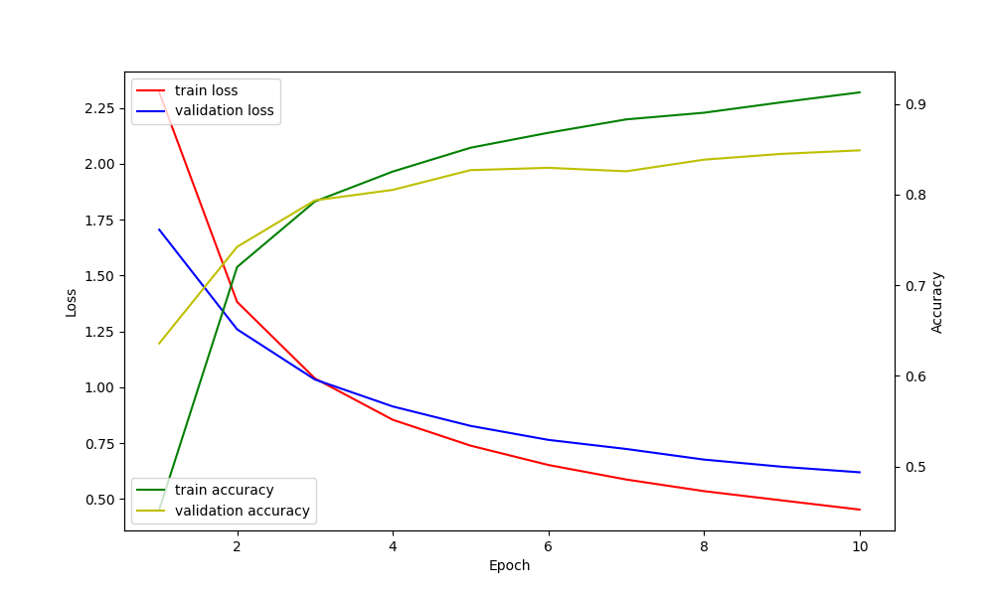
Vision Transformer (no.1) – Loss and Accuracy

Slide 7
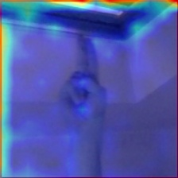
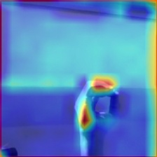
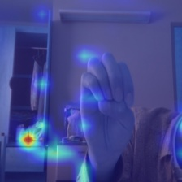
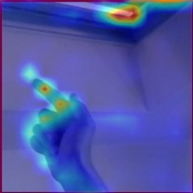
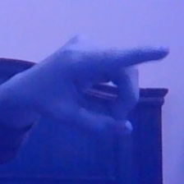
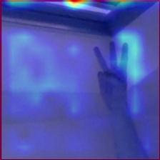
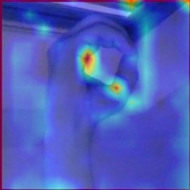
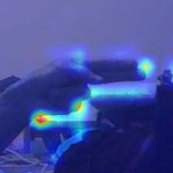
Vision Transformer (no.1) – Saliency Maps

Slide 8
ResNet50 (no.1)
Augmentierung: Spiegeln, Crop with padding n = 4

Slide 9
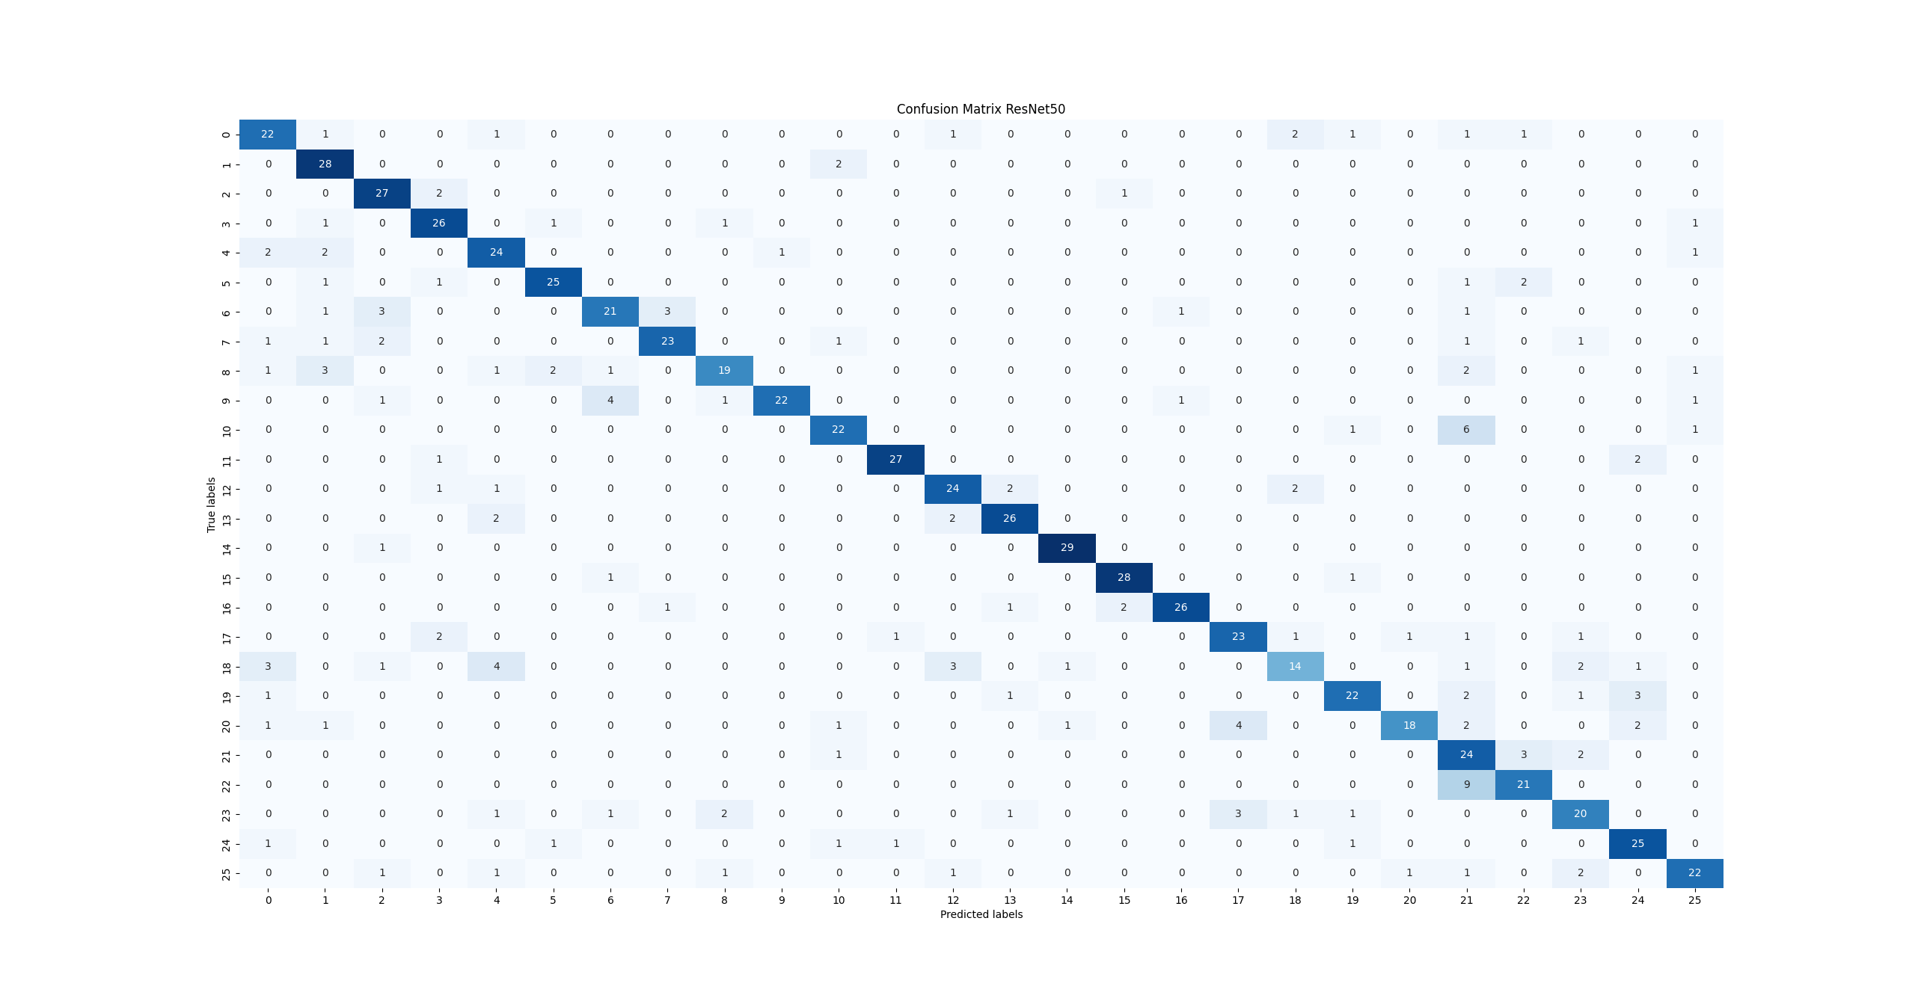
ResNet50 (no.1) – Confusion Matrix

Slide 10
ResNet50 (no.1) – Labels
Labels Testdaten:
[1, 7, 16, 21, 3, 22, 0, 25, 17, 19, 8, 4, 25, 2, 0, 16, 10, 9, 20, 21, 24, 18, 16, 15, 23, 8, 13, 1, 19, 3, 4, 10, 3, 17, 9, 8, 25, 24, 0, 20, 18, 21, 14, 3, 14, 16, 12, 9, 0, 2, 20, 14, 4, 25, 12, 13, 22, 0, 7, 11, 13, 22, 12, 19, 6, 18, 22, 5, 11, 14, 23, 3, 14, 22, 1, 25, 10, 12, 9, 24, 22, 3, 8, 25, 21, 11, 13, 5, 3, 23, 14, 6, 7, 21, 15, 4, 13, 10, 25, 20, 19, 19, 16, 1, 2, 11, 5, 5, 24, 25, 15, 20, 18, 20, 9, 6, 5, 20, 21, 7, 6, 7, 0, 17, 12, 11, 15, 2, 18, 6,
6, 22, 9, 24, 25, 9, 15, 13, 16, 4, 10, 7, 17, 11, 4, 16, 23, 18, 5, 14, 24, 7, 10, 11, 20, 1, 19, 19, 8, 10, 8, 20, 5, 19, 10, 18, 18, 15, 5, 8, 10, 15, 8, 2, 11, 8, 9, 18, 10, 3, 6, 3, 24, 2, 12, 22, 15, 11, 15, 2, 21, 0, 25, 18, 16, 1, 19, 11, 12, 7, 24, 16, 1, 17, 11, 6, 4, 2, 20, 20, 13, 6, 4, 4, 2, 3, 13, 20, 19, 25, 15, 5, 8, 11, 8, 18, 18, 1, 12, 2, 15, 0, 10, 11, 1, 13, 13, 13, 18, 2, 4, 22, 15, 17, 16, 24, 17, 12, 18, 24, 9, 1, 9, 14, 25, 25, 15, 19, 5, 25, 21, 4, 13, 22, 16, 1, 0, 13, 7, 0, 5, 25, 18, 2, 23, 7, 25, 21, 6, 3, 21, 3, 3, 0, 6, 10, 24, 16, 18, 17, 14, 20, 14, 0, 1, 9, 23, 21, 22, 17, 25, 14, 16, 25, 10, 10, 3, 23, 4, 18, 19, 24, 4, 7, 20, 12, 4, 9, 6, 10, 22, 23, 17, 5, 24, 8, 15, 6, 21, 15, 21, 19, 23, 5, 15, 23, 23, 12, 6, 1, 20, 14, 22, 3, 16, 8, 25, 23, 7, 9, 3, 16, 7, 1, 10, 2, 8, 12, 18, 4, 9, 22, 6, 2, 5, 14, 10, 12, 17, 7, 4, 22, 14, 13, 18, 12, 4, 2, 11, 10, 7, 21, 15, 22, 8, 25, 6, 16, 23, 20, 24, 7, 3, 1, 1, 10, 19, 19, 23, 11, 17, 21, 14, 13, 1, 17, 22, 2, 7, 22, 17, 20, 20, 5, 0, 15, 12, 24, 12, 2, 17, 20, 14, 20, 4, 19, 3, 17, 22, 8, 1, 7, 5, 17, 14, 21, 6, 8, 11, 0, 2, 21, 10, 12, 10, 13, 5, 18, 24, 22, 9, 0, 21, 3, 10, 17, 12, 20, 13, 7, 17, 16, 9, 17, 20, 6, 21, 7,
11, 18, 17, 18, 14, 19, 24, 3, 19, 23, 4, 5, 5, 10, 24, 23, 5, 6, 22, 14, 9, 19, 10, 23, 8, 19, 25, 18, 17, 18, 6, 22, 21, 9, 21, 6, 1, 1, 23, 8, 0, 14, 23, 23, 21, 25, 24, 8, 16, 17, 12, 11, 5, 16, 11, 22, 12, 7, 3, 0, 25, 1, 10, 8, 11, 24, 19, 20, 7, 3, 19, 0, 17, 9, 15, 22, 0, 9, 3, 16, 17, 4, 0, 15, 5, 0, 13, 18, 9, 1, 5, 5, 16, 4, 16, 18, 9, 24, 17, 13, 0, 22, 1, 10, 21, 25, 0, 16, 6, 25, 4, 19, 22, 3, 17, 10, 18, 8, 24, 8, 1, 13, 21, 23, 9, 8, 4, 6, 1, 7, 5, 19, 20, 11, 6, 8, 7,
4, 14, 12, 24, 6, 1, 2, 14, 0, 25, 19, 12, 15, 20, 9, 23, 22, 15, 0, 9, 2, 0, 15, 15, 24, 15, 1, 15, 11, 14, 13, 19, 12, 22, 14, 12, 16, 18, 7, 20, 17, 3, 0, 9, 14, 3, 14, 15, 7, 1, 14, 12, 13, 23, 5, 11, 21, 8, 24, 2, 13, 21, 2, 2, 16, 22, 25,
14, 20, 3, 17, 18, 10, 11, 18, 17, 9, 2, 6, 13, 21, 24, 16, 4, 4, 4, 11, 12, 14, 16, 11, 15, 13, 13, 24, 13, 19, 4, 24, 8, 11, 19, 21, 23, 23, 3, 1, 7, 5, 7, 3, 23, 4, 11, 9, 10, 6, 8, 1, 23, 16, 5, 0, 21, 23, 8, 2, 9, 13, 2, 7, 2, 25, 25, 2, 19, 15, 5, 9, 12, 6, 11, 11, 0, 12, 13, 14, 15, 6, 20, 16, 22, 2, 8, 10, 24, 3, 24, 7, 23, 5, 13, 12, 12, 21, 25, 16, 20, 2, 0, 6, 23, 19, 4, 20]
vorhergesagte Testdaten:
[1, 7, 15, 21, 3, 22, 4, 25, 17, 19, 8, 4, 8, 2, 0, 16, 10, 6, 20, 21, 24, 24, 16, 15, 23, 1, 13, 1, 19, 3, 4, 10, 3, 17, 6, 21, 23, 24, 0, 20, 4, 21, 14, 3, 14, 16, 12, 9, 0, 2, 20, 14, 4, 25, 12, 13, 22, 0, 2, 11, 13,
22, 12, 19, 7, 4, 22, 21, 11, 14, 4, 3, 14, 22, 1, 20, 10, 12, 9, 24, 22, 3, 21, 25, 21, 11, 13, 5, 8, 23, 14, 2, 7, 22, 15, 4, 13, 10, 2, 17, 19, 19, 16, 1, 2, 11, 5, 5, 11, 25, 15, 20, 23, 20, 16, 2, 5, 20, 21, 7, 6, 7, 0, 11, 12, 11, 15, 2, 4, 6, 7, 21, 25, 24, 21, 6, 15, 4, 16, 4, 10, 7, 17, 11, 4, 16, 18, 12, 5, 14, 24, 7, 10, 11, 17, 10, 19, 0, 6, 10, 8, 20, 22, 19, 10, 18, 18, 15, 5, 8, 10, 15, 25, 2, 11, 8, 9, 0, 10, 3, 6, 3, 24, 2, 12, 22, 15, 24, 15, 2, 21, 12, 25, 2, 16, 1,
19, 11, 12, 7, 24, 16, 1, 17, 11, 6, 4, 2, 21, 17, 12, 6, 4, 0, 3, 3, 13, 21, 19, 25, 15, 5, 8, 11, 8, 12, 18, 1, 12, 2, 6, 0, 10, 11, 1, 13, 13, 13, 18, 2, 4, 22, 15, 17, 16, 24, 17, 12, 18, 0, 9, 10, 9, 14, 25, 25, 15, 19, 5, 25, 21, 4, 13, 22, 16, 1, 19, 13, 7, 0, 5, 25, 12, 2, 23, 7, 25, 21, 6, 3, 23, 3, 3, 22, 6, 21, 24, 16, 18, 20, 14, 10, 14, 0, 1, 9, 23, 21, 21, 17, 25, 14, 16, 25, 10, 10, 3, 23, 4, 18, 13, 19, 4, 7, 17, 13, 4, 9, 6, 10, 22, 17, 17, 5, 24, 8, 15, 2, 21, 15, 21, 19, 6, 5, 15, 23, 23, 12, 6, 1, 20, 14, 22, 3, 16, 1, 25, 23, 7, 9, 3, 15, 7, 1, 10, 2, 0, 18, 14, 4, 9, 22, 1, 2, 5, 14, 21, 3, 17, 7, 25, 22, 14, 13, 18, 4, 4, 2, 11, 21, 1, 21, 15, 21, 1, 25, 6, 16, 23, 1, 24, 10, 1, 1, 1, 10, 19, 19, 23, 24, 23, 21, 14, 13, 1, 17, 22, 2, 23, 21, 17, 20, 20, 5, 0, 15, 18, 24, 12, 2, 3, 20, 14, 20, 4, 24, 3, 21, 22, 8, 1, 7, 5, 17, 14, 21, 6, 8, 11, 0, 2, 21, 21, 13, 10, 4, 22, 0, 24, 21, 9, 0, 23, 25, 10, 17, 12, 20, 12, 7, 17, 16, 9, 17, 20, 6, 21, 7, 3, 23, 3, 18, 14, 19, 24, 3, 19, 23, 0, 5, 5, 21, 24, 23, 5, 6, 22, 14, 8, 19, 25, 23, 8, 19, 4, 0, 17, 18, 16, 21, 21, 9, 21, 6, 1, 1, 23, 4, 21, 14, 8, 8, 21, 23, 24, 8, 16, 17, 12, 11, 5, 16, 11, 22, 12, 7, 3, 0, 25, 1, 10, 8, 11, 24, 23, 24, 21, 3, 24, 0, 17, 9, 15, 22, 0, 6, 3, 16, 18, 4, 0, 15, 5, 18, 13, 21, 9, 1, 5, 5, 16, 4, 16, 18, 9, 10, 17, 13, 0, 21, 1, 21, 22, 12, 18, 16, 6, 25, 4, 19, 22, 3, 17, 19, 4, 5, 24, 8, 1, 13, 22, 13, 9, 8, 4, 21, 1, 2, 3, 19, 20, 11, 6, 8, 7, 1, 14, 12, 24, 6, 1, 3, 14, 0, 25, 21, 12, 15, 14, 9, 23, 21, 15, 0, 9, 2, 0, 15, 19, 24, 15, 1, 15, 11, 2, 13, 24, 12, 21, 14, 12, 16, 18, 7, 20, 17, 3, 0, 9, 14, 5, 14, 15, 7, 1, 14, 12, 13, 17, 5, 11, 10, 8, 5, 2, 13, 21, 2, 2, 16, 22, 25, 14, 24, 3, 17, 18, 10, 11, 18, 17, 9, 2, 6, 13, 21, 24, 16, 9, 1, 4, 11, 12, 14, 16, 11, 15, 13, 13, 24, 13, 19, 4, 24, 5, 11, 19, 21, 23, 23, 3, 1, 7, 5, 7, 3, 23, 4, 11, 9, 10, 6, 8, 1, 19, 13, 1, 1, 21, 23, 8, 2, 2, 13, 2, 0, 2, 25, 25, 15, 21, 15, 5, 9, 12, 6, 11, 11, 0, 12, 13, 14, 15, 7, 20, 7, 22, 2, 8, 10, 24, 3, 24, 7, 17, 5, 13, 12, 12, 21, 25, 16, 20, 2, 0, 6, 23, 19, 4, 0]

Slide 11
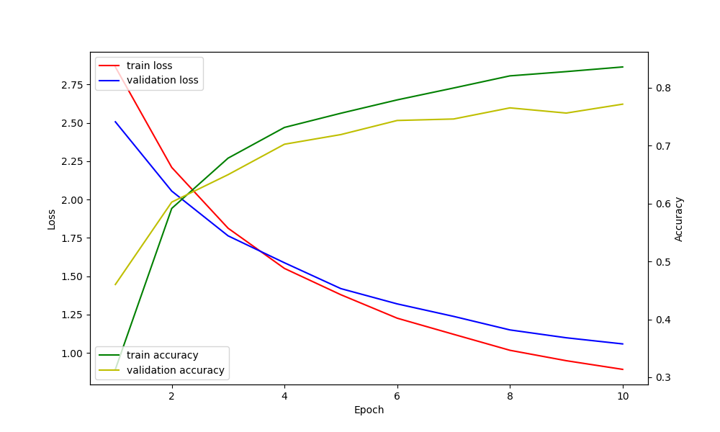
ResNet50 (no.1) – Loss and Accuracy

Slide 12
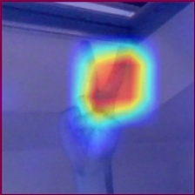
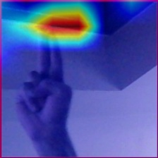
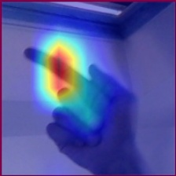
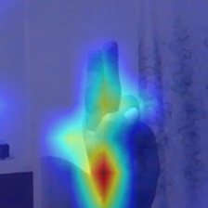
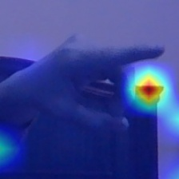
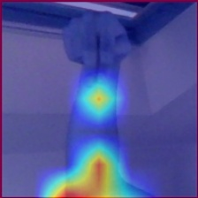
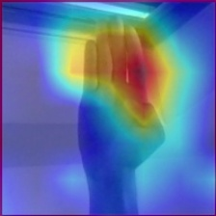
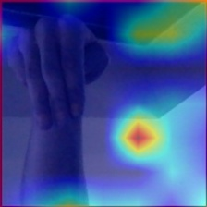
ResNet50 (no.1) – Saliency Maps

Slide 13
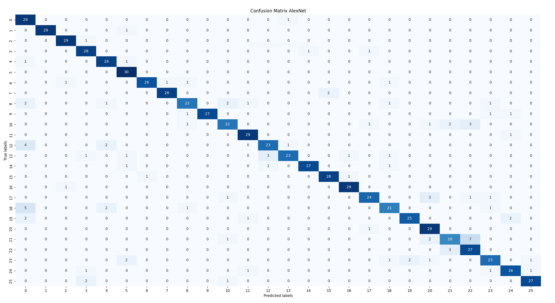
AlexNet –Confusion Matrix

Slide 14
AlexNet- Labels
Test Accuracy: 0.8705
Test Accuracy: 0.8705
Precision: 0.8769
Recall: 0.8705
F1-Score: 0.8700
Labels Testdaten: [4, 24, 22, 5, 5, 8, 22, 3, 17, 13, 0, 18, 4, 25, 8, 6, 1, 11, 25, 2, 2, 8, 25, 8, 8, 3, 13, 22, 21, 22, 0, 14, 17, 17, 20, 7, 12, 6, 18, 20, 21, 23, 16, 25, 9, 3, 2, 11, 23, 18, 11, 21, 3, 21, 20, 0, 25, 16, 24, 16, 22, 13, 2, 24, 21, 18, 9, 15, 24, 17, 20, 5, 24, 5, 9, 18, 13, 8, 15, 13, 5, 23, 6, 6, 22, 12, 3, 8, 0, 5, 20, 19, 5, 25, 13, 19, 9, 12, 16, 2, 20, 20, 24, 10, 16, 19, 5, 11, 14, 10, 23, 13, 17, 11, 12, 23, 8, 13, 15, 24, 1, 2, 9, 20, 5, 7, 19, 2, 20, 4, 18, 23, 15, 14, 6, 22, 23, 22, 19, 4, 17, 23, 4, 15, 25, 14, 7, 19, 22, 1, 6, 21, 12, 3, 7, 3, 6, 6, 21, 20, 15, 21, 13, 1, 23, 0, 19, 17, 7, 3, 11, 19, 22, 20, 20, 7, 23, 17, 22, 22, 13, 20, 2, 5, 14, 20, 11, 25, 21, 20, 0, 24, 17, 0,
12, 12, 14, 25, 2, 14, 4, 10, 2, 8, 6, 19, 16, 18, 2, 20, 2, 12, 3, 8, 7, 25, 20, 16, 22, 3, 12, 11, 25, 13, 8, 18, 8, 8, 10, 5, 20, 16, 19, 10, 20, 14, 17, 13, 19, 24, 15, 23, 4, 5, 10, 0, 18, 10, 14, 14, 23, 17, 3, 7, 0, 21, 3, 10, 15, 9, 9, 13, 12, 2, 10, 24, 2, 15, 18, 22, 1, 17, 3, 23, 7, 7, 22, 3, 15, 13, 5, 8, 24, 6, 5, 3, 1, 25, 21, 24, 14, 25, 11, 9, 0, 25, 24, 12, 17, 12, 21, 10, 24, 14, 8, 25, 8, 9, 16, 25, 3, 11, 11, 13, 2, 11, 7, 25, 9, 4, 15, 13, 2, 14, 5, 5, 4, 4,
7, 10, 7, 10, 1, 14, 21, 7, 18, 23, 11, 1, 20, 2, 9, 20, 4, 14, 11, 7, 18, 7, 2, 16, 11, 18, 24, 9, 21, 0, 14, 13, 23, 3, 22, 7, 23, 6, 2, 0, 3, 19, 16, 19, 4, 8, 0, 21, 14, 10, 3, 9, 13, 19, 13, 22, 0, 6, 23, 16, 7, 4, 7, 23, 10, 4, 9, 5, 25, 0, 6, 8, 17, 13, 0, 19, 10, 6, 17, 5, 16, 22, 23, 7, 9, 14, 0, 1, 7, 8, 4, 21, 24, 24, 18, 17, 15, 8, 7, 13, 11, 9, 2, 13, 21, 2, 15, 17, 12, 4, 24, 9, 24, 14, 2, 12, 17, 16, 6, 10, 12, 4, 9, 17, 16, 4, 19, 18, 19, 7, 8, 4, 6, 14, 15, 5, 13, 20, 16, 22, 15, 6, 10, 6, 4, 1, 15, 16, 25, 3, 18, 15, 14, 22, 5, 2, 1, 9, 22, 5, 6, 1, 23, 23, 6, 21, 8, 21, 6, 11, 14, 1, 19, 19, 22, 4, 15, 20, 8, 15, 7, 8, 18, 23, 10, 9, 12, 4, 22, 17, 22, 15, 6, 10, 5, 18, 5, 17, 25, 11, 11, 19, 2, 22, 11, 12, 18, 1, 0, 10, 8, 1, 3, 6, 17, 22, 16, 2, 19, 14, 5, 25, 23, 1, 2, 6, 25, 25, 17, 21, 5, 21, 0, 1, 3, 11, 18, 12, 18, 17, 25, 12, 7, 15, 21, 6, 13, 13, 1, 18, 15, 7, 14, 20, 24, 21, 23, 0, 17, 18, 24, 0, 1, 9, 14, 20, 7, 1, 16, 2, 16, 11, 8, 17, 3, 10, 24, 1, 15, 18, 1, 15, 15, 25, 8, 23, 1, 1, 15, 12, 10, 16, 17, 13, 9, 9, 11, 7, 22, 12, 25, 10, 1, 21, 11, 20, 19, 20, 20, 18, 4, 0, 8, 14, 14, 5, 12, 17, 25, 13, 10, 6, 9, 19, 4, 24, 12, 1, 16, 10, 8, 24, 18, 25, 6, 0, 10, 3, 23, 16, 17, 12, 16, 0, 12, 16, 24, 5, 15, 18, 1, 9, 19, 19, 9, 3, 25, 4, 7, 24, 16, 11, 10, 21, 23, 10, 6, 13, 10, 6, 0, 21, 11, 4, 25, 23, 19, 20, 9, 11, 24, 18, 23, 22, 17, 15, 18, 21, 14, 11, 5, 24, 5, 18, 12, 3, 13, 13, 14, 20, 8, 0, 14, 21, 12, 0, 9, 0, 16, 0, 12, 11, 1, 4, 3, 9, 2, 3, 3, 0, 22, 10, 2, 15, 11, 9, 24, 24, 5, 12, 22, 4, 4, 3, 7, 16, 15, 4, 1, 1, 19, 23, 19, 19, 12, 21, 19, 16, 16, 2, 6, 21]
vorhergesagte Testdaten: [4, 24, 22, 5, 5, 8, 21, 3, 17, 13, 0, 18, 4, 25, 8, 6, 5, 11, 3, 2, 2, 0, 25, 8, 11, 3, 13, 22, 21, 22, 0, 14, 17, 22, 20, 15, 0, 6, 18, 20, 20, 23, 16, 25, 9, 3, 2, 11, 23, 18, 11, 21, 3, 21, 20, 0, 25, 16, 11, 16,
22, 13, 2, 24, 21, 4, 9, 16, 24, 17, 20, 5, 24, 5, 9, 18, 13, 8, 15, 13, 5, 5, 2, 6, 22, 0, 3, 8, 0, 5, 20, 19, 5, 25, 3, 19, 9, 12, 16, 2, 20, 20, 24, 22, 16, 19, 5, 11, 14, 10, 23, 13, 20, 11, 4, 23, 8, 13, 15, 3, 1, 2, 9, 20, 5, 7, 19, 2,
20, 4, 18, 23, 15, 14, 6, 22, 23, 22, 0, 4, 17, 23, 4, 15, 25, 14, 7, 19, 22, 1, 6, 21, 12, 3, 7, 3, 6, 6, 21, 20, 15, 21, 13, 1, 19, 0, 19, 17, 7, 3, 11, 19, 22, 20, 20, 7, 23, 17, 22, 22, 13, 20, 2, 5, 14, 20, 11, 25, 10, 20, 0, 24, 17, 0,
12, 12, 14, 25, 2, 14, 4, 10, 2, 8, 6, 19, 16, 18, 2, 20, 2, 12, 14, 8, 15, 10, 20, 16, 22, 3, 12, 11, 25, 13, 8, 18, 8, 23, 10, 5, 20, 16, 24, 10, 20, 14, 17, 18, 19, 24, 15, 23, 4, 5, 20, 0, 18, 17, 14, 14, 23, 17, 3, 7, 0, 21, 3, 10, 15, 9, 9, 13, 13, 2, 10, 24, 2, 15, 18, 22, 1, 17, 3, 23, 7, 7, 22, 3, 15, 13, 5, 4, 24, 7, 5, 17, 1, 25, 22, 24, 14, 25, 11, 9, 0, 3, 24, 12, 10, 0, 21, 10, 24, 14, 8, 25, 8, 9, 16, 25, 3, 11, 11, 13, 3, 11, 7, 25, 9, 5, 15, 13, 2, 14, 5, 5, 4, 4, 7, 22, 7, 10, 1, 18, 21, 7, 0, 23, 11, 1, 20, 2, 9, 20, 4, 14, 11, 7, 18, 7, 2, 16, 11, 18, 24, 9, 21, 0, 14, 13, 23, 3, 22, 7, 23, 6, 2, 0, 3, 0, 16, 19, 4, 8, 0, 21, 14, 10, 3, 9, 5, 19, 13, 22, 0, 6, 23, 16, 7, 4, 7, 23, 10, 4, 8, 5, 25, 0, 6, 8, 17, 13, 0, 19, 10, 6, 17, 5, 16, 22, 23, 7, 9, 12, 0, 1, 7, 0, 4, 21, 24, 24, 18, 17, 15, 8, 7, 12, 11, 9, 2, 13, 22, 2, 15, 17, 0, 4, 24, 9, 24, 14, 2, 12, 17, 16, 6, 22, 12, 4, 9, 17, 16, 4, 19, 4, 19, 7, 8, 4, 6, 14, 15, 5, 13, 20, 16, 22, 15, 6, 21, 6, 4, 1, 15, 16, 25, 3, 0, 15, 14, 22, 5, 2, 1, 9, 21, 5, 6, 1, 23, 23, 18, 21, 8, 21, 6, 11, 14, 1, 19, 11, 22, 4, 15, 20, 8, 15, 7, 10, 23, 19, 21, 9, 12, 4, 22, 17, 22, 15, 6, 10, 5, 8, 5, 17, 25, 11, 11, 19, 2, 22, 11, 12, 0, 1, 0, 10, 10, 1, 3, 8, 17, 22, 16, 2, 19, 14, 5, 25, 23, 1, 2, 6, 25, 25, 17, 22, 5, 21, 0, 1, 3, 11, 18, 12, 18, 23, 25, 4, 7, 15, 21, 6, 13, 13, 1, 0, 15, 7, 5, 20, 24, 22, 25, 0, 17, 18, 24, 0, 1, 9, 14, 20, 7, 1, 16, 2, 16, 11,
8, 17, 3, 10, 24, 1, 6, 18, 1, 15, 15, 25, 8, 23, 1, 1, 15, 12, 10, 16, 20, 12, 9, 23, 11, 7, 22, 12, 25, 10, 1, 20, 11, 20, 19, 20, 20, 18, 4, 0, 18, 14, 14, 5, 12, 20, 25, 16, 10, 6, 9, 24, 4, 24, 12, 1, 16, 10, 8, 24, 0, 25, 6, 0, 10, 3, 20, 16, 17, 12, 16, 0, 12, 16, 24, 5, 15, 18, 1, 24, 19, 19, 9, 3, 25, 4, 7, 23, 16, 11, 8, 21, 5, 10, 6, 12, 10, 6, 0, 22, 11, 4, 25, 23, 19, 20, 9, 11, 24, 18, 23, 21, 17, 15, 18, 22, 14, 11, 5, 25, 5, 18, 12, 3, 13, 13, 14, 17, 8, 0, 14, 22, 12, 13, 9, 0, 16, 0, 12, 11, 1, 4, 3, 9, 2, 3, 3, 0, 22, 10, 2, 15, 24, 9, 24, 24, 5, 12, 22, 4, 0, 3, 7, 16, 15, 4, 1, 1, 19, 18, 19, 19, 12, 21, 19, 16, 2, 2, 6, 21]

Slide 15
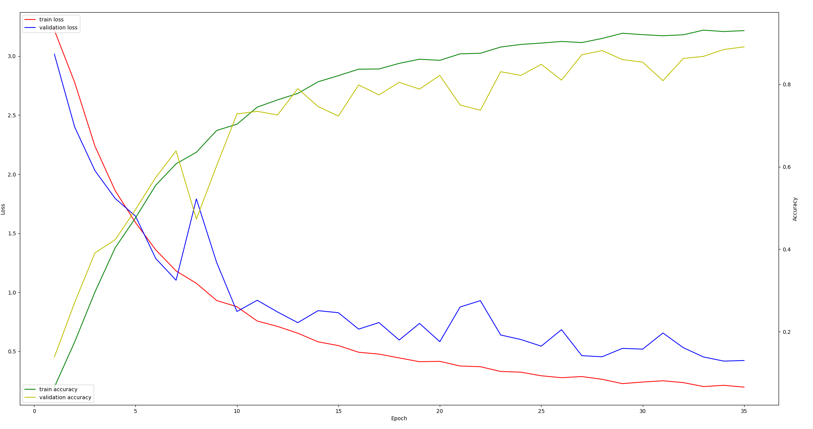
AlexNet –Loss and Accuracy

Slide 16
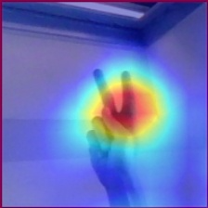
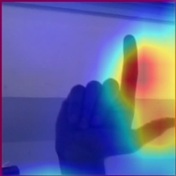
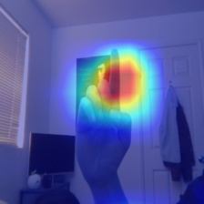
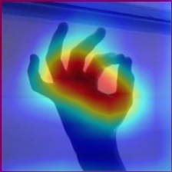
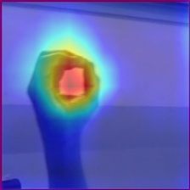
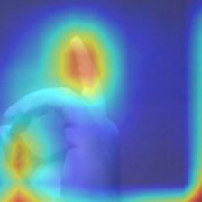
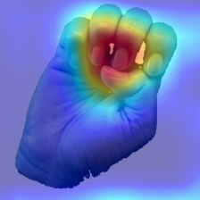
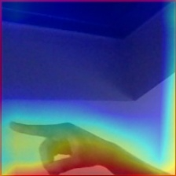
AlexNet – Saliency Maps

Slide 17
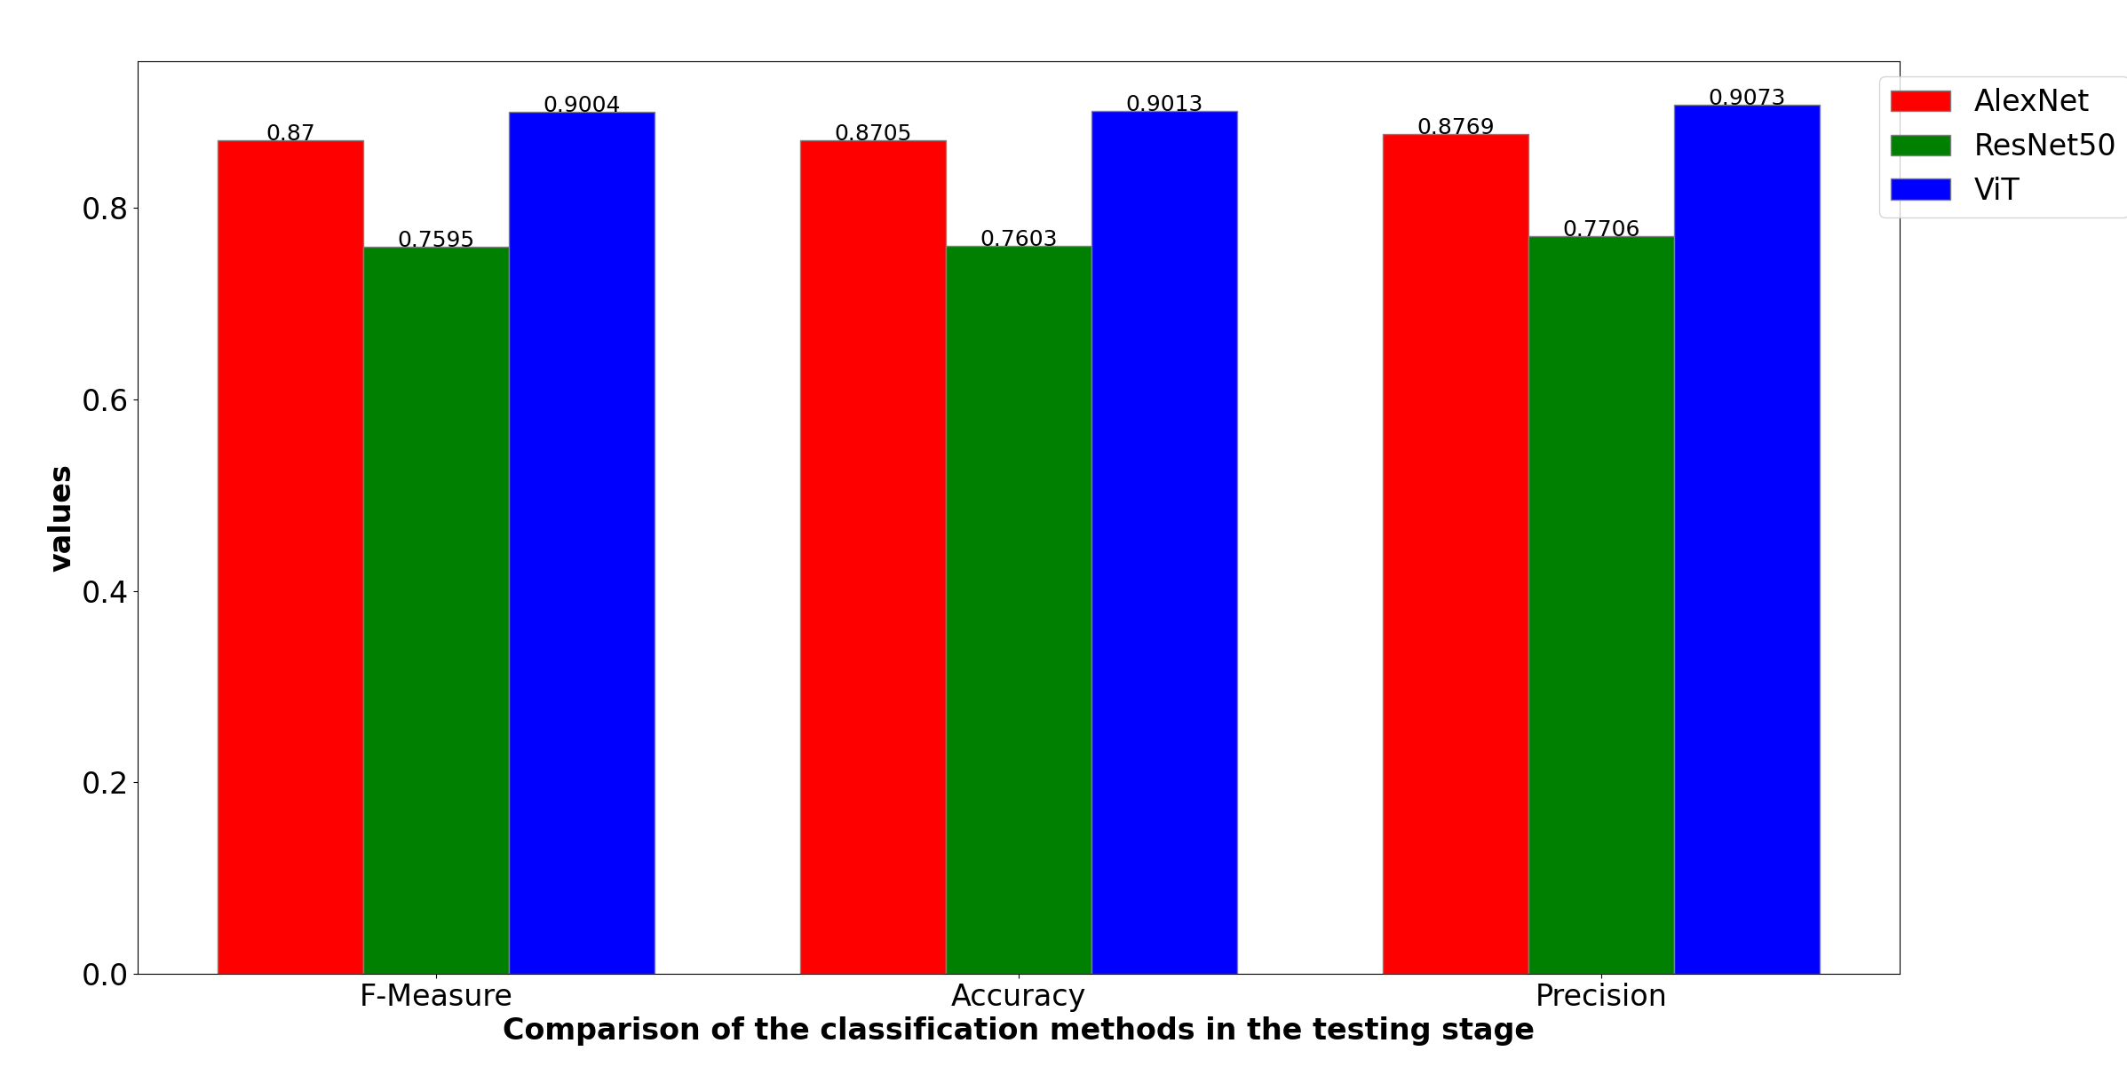

Slide 18
ResNet50 on new Dataset
Augmentierung: Spiegeln, Crop with padding n = 4

Slide 19
Trial 0 finished with value: 0.7784011220196353 and parameters: {'learning_rate': 0.0006965942314459044, 'batch_size': 64, 'num_epochs': 10}. Best is trial 0 with value: 0.7784011220196353.
Beste Hyperparameter: {'learning_rate': 0.0006965942314459044, 'batch_size': 64, 'num_epochs': 10}
Bester Validierungsverlust: 0.7784011220196353
Epoch 1/10, Loss: 2.6664, Accuracy: 0.3958
Epoch 2/10, Loss: 1.9060, Accuracy: 0.6386
Epoch 3/10, Loss: 1.5304, Accuracy: 0.7085
Epoch 4/10, Loss: 1.3135, Accuracy: 0.7431
Epoch 5/10, Loss: 1.1643, Accuracy: 0.7680
Epoch 6/10, Loss: 1.0487, Accuracy: 0.7863
Epoch 7/10, Loss: 0.9651, Accuracy: 0.7986
Epoch 8/10, Loss: 0.9009, Accuracy: 0.8123
Epoch 9/10, Loss: 0.8358, Accuracy: 0.8261
Epoch 10/10, Loss: 0.7837, Accuracy: 0.8329
Final Validation Loss: 0.9445, Final Validation Accuracy: 0.7714
Test Accuracy: 0.7811
Test Accuracy: 0.7811
Precision: 0.7849
Recall: 0.7811
F1-Score: 0.7808

Slide 20
ResNet50 on new Dataset - Labels
Labels Testdaten:
[25, 4, 15, 16, 7, 23, 12, 4, 24, 17, 10, 7, 1, 1, 1, 0, 13, 2, 20, 4, 11, 17, 4, 16, 24, 16, 0, 15, 25, 8, 15, 16, 21, 4, 16, 6, 10, 20, 14, 17, 11, 18, 23, 11, 14, 25, 12, 22, 20, 15, 18, 3, 15, 14, 14, 5, 5, 24, 13, 3, 20, 14, 24, 14, 21, 6, 4, 3, 11, 17, 3, 10, 1, 18, 11, 10, 9, 8, 2, 15, 4, 3, 8, 10, 17, 25, 18, 7, 5, 19, 7, 6, 18, 18, 15, 24, 25, 8, 16, 11, 24, 22, 11, 2, 21, 14, 22, 21, 15, 22, 16, 9, 22, 16, 11, 22, 16, 16, 1, 21, 21, 22, 12, 5, 6, 4, 7, 18, 20, 8, 16, 12, 21, 6, 20, 1, 9, 19, 13, 13, 1, 20, 21, 18, 23, 21, 22, 18, 4, 20, 24, 0, 15, 12, 25, 18, 13, 6, 3, 6, 9, 21, 24, 11, 11, 24, 4, 16, 14, 21, 13, 21, 2, 9, 3, 7, 9, 3, 12, 2, 8, 15, 2, 17, 0, 2, 17, 2, 0, 22, 3, 7, 2, 22, 23, 5, 14, 9, 2, 17, 1, 18, 17, 12, 4, 21, 3, 6, 12, 14, 0, 25, 23, 13, 23, 22, 19, 21, 23, 0, 7, 12, 24, 23, 6, 15, 18, 16, 18, 4, 21, 25, 8, 10, 14, 14, 3, 15, 6, 20, 25, 10, 5, 20, 20, 16, 8, 0, 11, 9, 9, 9, 18, 9, 17, 6, 18, 1, 7, 21, 24, 23, 11, 19, 18, 17, 5, 5, 1, 13, 3, 12, 25, 21, 20, 22, 6, 18, 1, 16, 4, 12, 25, 12, 5, 21, 10, 23, 19, 4, 1, 6, 10, 1, 18, 15, 20, 9, 17, 1, 11, 22, 8, 22, 10, 5, 18, 0, 9, 16, 8, 19, 19, 14, 17, 19, 0, 1, 13, 20, 2, 19, 20, 4, 14, 20, 14, 13, 11, 5, 22, 15, 15, 12, 10, 9, 19, 19, 12, 9, 7, 15, 4, 19, 18, 0, 23, 11, 13, 14, 11, 14, 19, 0, 23, 20, 12, 2, 15, 22, 10, 21, 19, 8, 1, 2, 22, 11, 21, 25, 3, 12, 10, 20, 19, 1, 6, 4, 19, 22, 13, 10, 9, 25, 4, 3, 9, 7, 3, 5, 8, 24, 0, 2, 20, 19, 11, 3, 19, 8, 19, 12, 7, 18, 18, 23, 5, 4, 16, 18, 24, 16, 9, 8, 2, 7, 24, 16, 4, 9, 8, 6, 11, 17, 10, 22, 14, 6, 16, 6, 0, 23, 8, 17, 1, 7, 6, 10, 16, 3, 18, 7, 3, 25, 3, 1, 23, 1, 23, 23, 1, 8, 8, 24, 16, 22, 13, 19, 23, 17, 8, 4, 2, 1, 4, 10, 21, 24, 12, 9, 21, 5, 24, 11, 19, 16, 13, 4, 18, 4, 16, 15, 11, 8, 17, 14, 19, 12, 18, 23, 10, 13, 22, 16, 8, 21, 21, 11, 19, 6, 24, 14, 1, 7, 24, 20, 8, 19, 8, 14, 6, 2, 14, 9, 19, 11, 4, 11, 10, 22, 23, 14, 1, 5, 2, 11, 22, 7, 1, 7, 11, 18, 7, 25, 4, 12, 20, 1, 8, 10, 8, 5, 8, 10, 8, 15, 15, 24, 0, 25, 21, 19, 18, 15, 14, 19, 25, 9, 2, 5, 14, 17, 19, 15, 16, 6, 22, 13, 12, 22, 12, 13, 20, 11, 14, 7, 9, 11, 17, 3, 24, 9, 11, 9, 4, 7, 5, 11, 18, 8, 7, 1, 25, 6, 2, 4, 24, 10, 22, 10, 23, 13, 22, 4, 2,
23, 13, 6, 6, 1, 23, 15, 12, 16, 7, 17, 22, 15, 23, 0, 25, 2, 14, 9, 14, 25, 5, 11, 6, 8, 0, 0, 2, 4, 22, 6, 21, 21, 12, 24, 9, 4, 2, 19, 16, 0, 3, 10, 9, 10, 15, 21, 10, 10, 12, 9, 11, 15, 22, 0, 12, 15, 6, 23, 2, 20, 21, 3, 5, 7, 9, 23, 2, 25, 12, 23, 1, 8, 14, 5, 6, 5, 7, 5, 11, 9, 5, 5, 17, 8, 19, 3, 25, 18, 1, 17, 24, 0, 11, 2, 0, 2, 8, 2, 3, 23, 24, 21, 15, 13, 20, 24, 16, 11, 19, 25, 24, 12, 17, 24, 7, 22, 10, 3, 12, 8, 18, 9, 5, 24, 14, 15, 4, 25, 23, 3, 3, 14, 24, 8, 0, 16, 1, 2, 14, 0, 0, 5, 22, 1, 12, 6, 14, 15, 5, 18, 1, 1, 11, 5, 19, 5, 18, 24, 13, 16, 1, 24, 2, 24, 9, 3, 19, 10, 13, 21, 10, 20, 25, 22, 18, 16,
3, 5, 21, 1, 10, 5, 22, 7, 5, 8, 5, 21, 4, 25, 12, 14, 16, 19, 21, 9, 8, 0, 19, 1, 22, 0, 7, 6, 5, 7, 2, 24, 17, 6, 5, 18, 24, 7, 8, 23, 23, 8, 20, 10, 16, 11, 15, 19, 3, 9, 22, 12, 12, 21, 23, 24, 19, 11, 21, 3, 15, 13, 8, 25, 1, 9, 7, 20, 23, 18, 1, 16, 18, 13, 16, 21, 9, 15, 7, 16, 13, 15, 22, 6, 6, 16, 13, 22,
23, 0, 9, 23, 3, 22, 16, 20, 17, 20, 3, 20, 8, 10, 4, 25, 24, 20, 23, 15, 23, 8, 6, 25, 8, 13, 10, 0, 22, 23, 7, 25, 9, 0, 23, 0, 5, 19, 19, 15, 2, 4, 23, 8, 1, 25, 10, 24, 1, 3, 13, 18, 7, 19, 25, 16, 15, 6, 24, 5, 17, 17, 7, 13, 14, 1, 2, 12, 15, 18, 14, 22, 6, 2, 10, 6, 2, 25, 22, 8, 21, 14, 1, 0, 11, 23, 21, 3, 9, 13, 20, 12, 0, 21, 16, 3, 1, 24, 5, 1, 18, 18, 25, 25, 7, 19, 5, 5, 19, 12, 9, 2, 5, 12, 14, 16, 9, 18, 8, 10, 5, 0, 17, 20, 22, 19, 3, 24, 21, 23, 1, 14, 15, 24, 7, 11, 6, 17, 25, 3, 25, 11, 3, 16, 17, 9, 13, 7, 6, 13, 15, 3, 14, 17, 12, 10, 22, 9, 21, 18, 20, 2, 14, 6, 1, 10, 6, 22, 19, 16, 13, 19, 23, 11, 1, 0, 0, 22, 5, 0, 1, 5, 12, 14, 3, 17, 10, 9, 7, 12, 13, 4, 10, 5, 8, 12, 1, 20, 9, 8, 17, 10, 4, 21, 19, 7, 25, 25, 22, 13, 18, 5, 11, 24, 23, 25, 14, 11, 19, 24, 24, 15, 2, 5, 15, 15, 23, 4, 21, 2, 21, 5, 13, 17, 15, 0, 7, 17, 24, 17, 11, 1, 9, 20, 6, 16, 10, 25, 9, 3, 24, 17, 3, 10, 14, 9, 6, 6, 1, 5, 14, 9, 9, 20, 0, 9, 4, 10, 11, 18, 13, 21, 5, 5, 24, 17, 17, 4, 6, 17, 16, 19, 7, 10, 13, 2, 9, 4, 23, 6, 0, 3, 24, 18, 22, 0, 1, 8, 0, 3, 14, 20, 9, 0, 4, 11, 12, 24, 17, 22, 10, 24, 18, 19, 8, 20, 0, 6, 6, 24, 22, 17, 17, 7, 25, 20, 14, 20, 25, 22, 2, 15, 7, 21, 11, 22, 23, 13, 3, 1, 17, 23, 13, 16, 4, 12, 18, 6, 0, 17, 4,
10, 19, 23, 1, 5, 7, 18, 4, 2, 7, 8, 20, 7, 9, 15, 17, 6, 9, 3, 20, 18, 3, 7, 7, 3, 13, 12, 3, 7, 2, 8, 5, 10, 22, 17, 21, 2, 10, 2, 25, 0, 23, 25, 2, 13, 0, 22, 18, 9, 11, 2, 14, 3, 8, 21, 2, 15, 8, 15, 6, 14, 8, 3, 12, 17, 4, 0, 25, 23, 14, 6, 20, 3, 3, 0, 0, 16, 6, 10, 15, 17, 7, 14, 7, 16, 14, 18, 1, 2, 18, 11, 22, 20, 23, 22, 8, 2, 7, 20, 20, 20, 21, 11, 16, 6, 20, 17, 0, 20, 16, 18, 15, 17, 14, 10, 25, 19, 16, 12, 21, 0, 12, 4, 6, 21, 7, 20, 21, 5, 13, 2, 0, 21, 17, 13, 10, 23, 3, 25, 4, 4, 20, 24, 17, 23, 6, 22, 15, 1, 13, 19, 17, 10, 12, 4, 17, 10, 24, 20, 24, 17, 24, 18, 11, 12, 25, 7, 5, 3, 14, 7, 6, 20, 10, 13, 10, 15, 25, 14, 0, 8, 24, 8, 18, 2, 18, 3, 25, 4, 19, 10, 5, 1, 21, 14, 12, 12, 18, 11, 17]
vorhergesagte Testdaten:
[25, 18, 15, 16, 7, 23, 12, 4, 24, 17, 10, 24, 1, 1, 1, 12, 13, 2, 20, 4, 11, 17, 0, 16, 24, 16, 0, 15, 25, 8, 15, 16, 21, 4, 16, 6, 10, 20, 14, 17, 11, 18, 23, 11, 14, 25, 12, 21, 13, 15, 23, 3, 15, 14, 14, 5, 5, 3, 13, 3, 20, 14, 24, 14, 4, 0, 25, 3, 11, 17, 14, 10, 1, 12, 11, 10, 9, 8, 2, 15, 4, 3, 8, 10, 17, 25, 18, 7, 5, 19, 6, 6, 18, 12, 15, 24, 25, 8, 15, 11, 24, 22, 11, 2, 21, 14, 24, 21, 15, 22, 15, 9, 22, 16, 24, 21, 16, 16, 1, 21, 21, 22, 12, 5, 6, 8, 7, 0, 21, 20, 16, 12, 10, 6, 20, 1, 9, 19, 13, 12, 1, 20, 22, 13, 23, 21, 22, 18, 4, 20, 12, 0, 15, 18, 25, 18, 13, 25, 3, 10, 19, 21, 6, 11, 11, 24, 4, 16, 14, 21, 13, 21, 2, 9, 3, 7, 9, 3, 13, 14, 8, 15, 2, 20, 0, 2, 17, 2, 0, 22, 3, 7, 2, 22, 20, 5, 14, 9, 2, 21, 1, 0, 17, 12, 0, 22, 3, 6, 12, 14, 0, 24, 23, 13, 23, 22, 19, 21, 5, 0, 7, 12, 24, 19, 6, 15, 17, 16, 23, 4, 21, 25, 8, 23, 14, 14, 3, 15, 6, 20, 24, 10, 5, 20, 20, 16, 4, 0, 11, 5, 9, 9, 4, 9, 17, 6, 0, 19, 23, 21, 24, 18, 11, 9, 0, 20, 5, 5, 1, 1, 8, 12, 25, 23, 17, 22, 6, 18, 1, 15, 4, 12, 25, 12, 5, 21, 10, 20, 19, 19, 23, 6, 10, 1, 18, 15, 20, 9, 17, 1, 11, 21, 17, 22, 10, 5, 18, 0, 9, 16, 22, 19, 19, 14, 17, 19, 0, 1, 20, 20, 2, 19, 10, 4, 14, 20, 14, 13, 11, 5, 22, 15, 15, 13, 10, 9, 19, 19, 12, 9, 7, 15, 4, 24, 18, 0, 23, 11, 13, 14, 11, 14, 19, 4, 23, 0, 13, 2, 15, 21, 21, 21, 24, 8, 1, 2, 22, 11, 21, 25, 3, 12, 10, 20, 19, 1, 6, 0, 19, 21, 13, 10, 9, 24, 4, 3, 17, 7, 3, 5, 10, 24, 0, 2, 20, 23, 11, 3, 19, 8, 19, 12, 7, 18, 18, 23, 5, 4, 16, 18, 24, 16, 20, 10, 2, 7, 24, 16, 4, 9, 8, 6, 11, 17, 10, 22, 14, 7, 16, 6, 0, 5, 6, 3, 10, 7, 6, 22, 16, 3, 18, 24, 8, 25, 1, 1, 23, 20, 0, 23, 1, 1, 8, 2, 16, 22, 13, 4, 23, 17, 8, 4, 2, 1, 4, 8, 22, 24, 12, 9, 21, 5, 24, 11, 19, 16, 12, 13, 24, 4, 16, 15, 11, 21, 17, 14, 21, 12, 18, 23, 10, 13, 22, 16, 8, 17, 20, 5, 19, 6, 11, 14, 1, 7, 24, 20, 8, 18, 25, 14, 6, 2, 14, 9, 24, 11, 4, 11, 10, 22, 23, 14, 1, 5, 2, 11, 22, 7, 1, 7, 11, 12, 7, 14, 4, 12, 23, 1, 6, 10, 6, 5, 8, 10, 8, 15, 15, 24, 0, 13, 21, 19, 13, 15, 14, 19, 21, 11, 2, 5, 14, 17, 19, 15, 16, 6, 22, 13, 0, 22, 13, 25, 20, 11, 14, 7, 9, 11, 17, 3, 6, 9, 11, 9, 4, 9, 5, 11, 18, 8, 7, 1, 25, 6, 2, 3, 24, 21, 22, 22, 23, 13, 24, 1, 14, 23, 24, 6, 6, 1, 23, 15, 12, 16, 7, 17, 22, 15, 8, 0, 25, 2, 21, 9, 14, 25, 5, 11, 6, 3, 0, 14, 2, 4, 21, 6, 21, 21, 12, 24, 9, 4, 2, 19, 16, 0, 3, 10, 9, 10, 15, 21, 17, 10, 13, 9, 5, 15, 22, 0, 12, 15, 6, 23, 2, 20, 21, 3, 24, 7, 9, 23, 2, 25, 12, 4, 1, 8, 14, 5, 14, 5, 7, 5, 6, 9, 5, 5, 17, 3, 19,
3, 25, 18, 22, 3, 24, 0, 11, 2, 0, 2, 8, 2, 3, 23, 24, 21, 15, 13, 20, 24, 15, 11, 19, 25, 24, 4, 17, 24, 7, 22, 10, 3, 12, 25, 18, 9, 5, 17, 14, 15, 4, 25, 23, 3, 3, 14, 11, 8, 0, 16, 1, 2, 14, 0, 0, 5, 22, 1, 12, 6, 14, 15, 5, 18, 1, 1, 11, 5, 0, 5, 18, 24, 13, 16, 1, 24, 2, 11, 9, 3, 19, 10, 12, 21, 10, 20, 9, 17, 18, 16, 3, 5, 0, 1, 6, 5, 22, 7, 22, 11, 5, 21, 4, 25, 12, 14, 16, 19, 21, 6, 8, 0, 19, 1, 22, 0, 7, 6, 5, 7, 2, 24, 17, 6, 5, 4, 24, 7, 0, 23, 23, 8, 1, 10, 16, 11, 15, 17, 3, 9, 22, 12, 12, 21, 13, 24, 19, 11, 21, 24, 15, 13, 8, 8, 1, 6, 7, 20, 23, 18, 1, 16, 23, 13, 16, 22, 9, 15, 7, 16, 12, 15, 22, 6, 6, 16, 4, 22, 23, 0, 9, 23, 3, 22, 16, 20, 23, 21, 14, 21, 25, 10, 4, 25, 23, 17, 21, 15, 23, 8, 18, 25, 8, 13, 10, 0, 22, 23, 7, 25, 9, 0, 18, 24, 5, 19, 24, 16, 2, 4, 23, 25, 1, 25, 10, 24, 1, 3, 12, 18, 25, 23, 25, 7, 15, 6, 24, 5, 21, 20, 7, 13, 14, 1, 2, 12, 15, 15, 14, 22, 6, 2, 10, 6, 2, 25, 21, 8, 21, 14, 1, 0, 11, 23, 21, 3, 25, 13, 20, 12, 0, 22, 16, 3, 1, 24, 5, 1, 18, 18, 25, 25, 3, 19, 1, 5, 24, 12, 9, 2, 5, 12, 14, 16, 9, 18, 4, 5, 5, 0, 17, 20, 22, 0, 3, 24, 21, 23, 1, 14, 15, 19, 7, 11, 6, 20, 25, 3, 25, 11, 3, 16, 21, 8, 13, 7, 6, 13, 15, 3, 14, 17, 12, 10, 10, 9, 21, 18, 20, 2, 11, 6, 1, 22, 6, 8, 19, 15, 0, 19,
17, 11, 1, 0, 0, 22, 22, 0, 1, 12, 12, 14, 3, 17, 10, 9, 7, 1, 13, 4, 10, 5, 8, 12, 1, 20, 9, 8, 17, 10, 1, 21, 19, 7, 11, 25, 22, 13, 18, 5, 11, 10, 23, 25, 14, 11, 19, 24, 5, 7, 25, 5, 15, 15, 18, 4, 10, 2, 21, 5, 13, 17, 15, 0, 7, 17, 24, 17, 3, 1, 24, 20, 6, 16, 1, 25, 9, 3, 24, 20, 3, 10, 14, 9, 6, 6, 1, 5, 14, 9, 9, 20, 0, 8, 4, 21, 11, 18, 13, 22, 5, 5, 24, 17, 20, 4, 24, 7, 16, 19, 7, 10, 13, 2, 9, 4, 23, 6, 0, 3, 12, 2, 22, 19, 2, 8, 0, 3, 14, 20, 9, 0, 4, 11, 18, 24, 17, 22, 21, 24, 18, 19, 8, 20, 1, 6, 7, 2, 22, 17, 17, 7, 25, 21, 14, 23, 15, 22, 2, 15, 7, 21, 11, 22, 8, 13, 3, 1, 17, 23, 12, 16, 4, 18, 4, 7, 0, 17, 0, 10, 19, 23, 1, 5, 7, 18, 4, 2, 6, 18, 20, 7, 9, 6, 17, 6, 9, 3, 12, 18, 3, 7, 7, 3, 13, 12, 11, 7, 6, 8, 5, 10, 4, 20, 21, 4, 20, 2, 20, 0, 23, 11, 10, 13, 22, 22, 18, 9, 11, 2, 14, 3, 8, 21, 2, 15, 8, 15, 7, 14, 20, 3, 12, 17, 23, 18, 25, 23, 14, 6, 20, 3, 3, 0, 0, 16, 6, 10, 15, 17, 7, 14, 7, 16, 17, 18, 10, 14, 4, 11, 22, 20, 23, 21, 8, 2, 7, 20, 22, 20, 10, 11, 16, 6, 17, 17, 0, 17, 16, 17, 15, 17, 14, 10, 4, 19, 16, 12, 21, 0, 12, 0, 6, 21, 7, 20, 21, 5, 13, 2, 0, 21, 17, 13, 0, 0, 3, 25, 4, 4, 17, 6, 17, 23, 14, 21, 15, 1, 13, 19, 17, 10, 12, 4, 17, 25, 24, 4, 24, 17, 24, 21, 11, 20, 20, 7, 5, 3, 14, 7, 6, 17, 10, 13, 10, 16, 25, 14, 0, 19, 24, 8, 18, 2, 0, 3, 25, 0, 8, 10, 22, 1, 10, 14, 13, 12, 13, 4, 17]

Slide 21
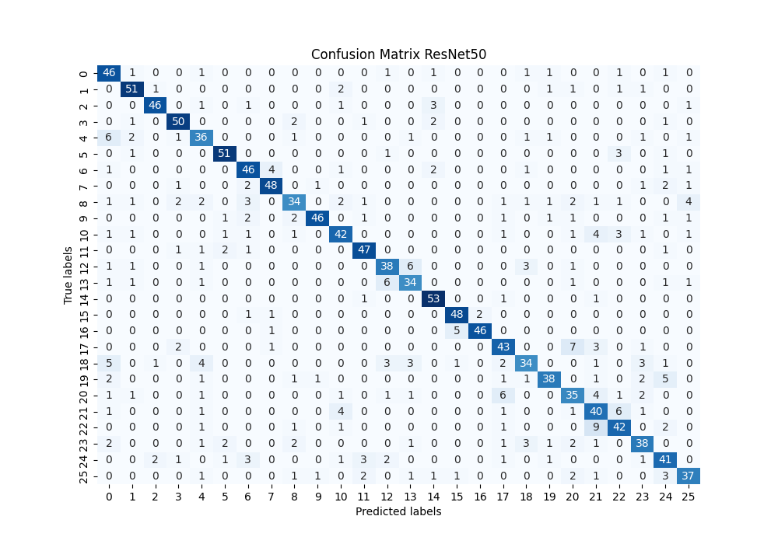
ResNet50 on new Dataset – Confusion Matrix

Slide 22
ResNet50 on new Dataset – Lost and Accuracy

Slide 23
ResNet50 on new Dataset – Saliency Maps

Slide 24
Vision Transformer on new Dataset
Augmentierung: Spiegeln, Crop with padding n = 4

Slide 25
Vision Transformer on new Dataset
Trial 0 finished with value: 0.8842917251051893 and parameters: {'learning_rate': 0.004285920769950295, 'batch_size': 64, 'num_epochs': 10}. Best is trial 0 with value: 0.8842917251051893.
Beste Hyperparameter: {'learning_rate': 0.004285920769950295, 'batch_size': 64, 'num_epochs': 10}
Bester Validierungsverlust: 0.8842917251051893
Epoch 1/10, Loss: 1.0807, Accuracy: 0.7005
Epoch 2/10, Loss: 0.4877, Accuracy: 0.8651
Epoch 3/10, Loss: 0.3679, Accuracy: 0.8959
Epoch 4/10, Loss: 0.3177, Accuracy: 0.9037
Epoch 5/10, Loss: 0.2599, Accuracy: 0.9241
Epoch 6/10, Loss: 0.2318, Accuracy: 0.9322
Epoch 7/10, Loss: 0.2091, Accuracy: 0.9394
Epoch 8/10, Loss: 0.1951, Accuracy: 0.9430
Epoch 9/10, Loss: 0.1852, Accuracy: 0.9455
Epoch 10/10, Loss: 0.1602, Accuracy: 0.9512
Final Validation Loss: 0.4258, Final Validation Accuracy: 0.8773

Slide 26
Vision Transformer on new Dataset - Labels
Labels Testdaten:
[6, 5, 9, 22, 18, 3, 13, 25, 21, 13, 12, 1, 22, 14, 9, 25, 13, 22, 3, 19, 19, 5, 0, 24, 5, 14, 5, 9, 13, 15, 12, 20, 5, 12, 7, 16, 23, 23, 1, 10, 11, 25, 24, 10, 7, 6, 18, 17, 12, 17, 6, 18, 15, 22, 24, 17, 20, 24, 10, 24, 24, 17, 5, 13, 10, 3, 23, 9, 4, 7, 22, 10, 25, 25, 18, 8, 7, 20, 17, 9, 4,
1, 16, 18, 4, 2, 2, 1, 13, 11, 25, 20, 22, 17, 12, 15, 18, 24, 21, 1, 0, 10, 9, 17, 22, 14, 17, 9, 20, 4, 3, 17, 1, 23, 25, 24, 25, 23, 2, 4, 10, 7, 24, 6, 1, 24, 1, 5, 3, 8, 2, 0, 18, 7, 10, 14, 1, 8, 21, 4, 1, 0, 2, 11, 25, 6, 5, 20, 8, 19, 20, 21, 24, 19, 4, 8, 3, 1, 0, 16, 20, 16, 17, 5, 24, 17, 13, 8, 1, 18, 20, 4, 12, 19, 12, 25, 11, 3, 2, 20, 17, 19, 16, 11, 15, 14, 9, 11, 2, 3, 24, 2, 5, 4, 10, 6, 19, 1, 25, 1, 8, 0, 12, 9, 18, 13, 0, 18, 0, 25, 9, 8, 2, 7, 22, 17, 20, 19, 1, 11, 6, 24, 18, 20, 13, 4, 0, 19, 3, 25, 9, 24, 13, 19, 25, 24, 21, 22, 6, 17, 21, 14, 15, 15, 20, 9, 17, 0, 4, 17, 24, 0, 5, 8, 4, 9, 20, 23, 5, 23, 14, 0, 9, 12, 23, 24, 25, 25, 16, 17, 21, 20, 15, 24, 11, 5, 25, 13, 19, 14, 12, 20, 21, 23, 2, 24, 4, 12, 16, 11, 12, 7, 11, 5, 18, 18, 7, 12, 17, 22, 25, 20, 19, 3, 0, 19, 8, 15, 11, 7, 5, 23, 25, 7, 9, 20, 9, 2, 22, 17, 17, 10, 25, 15, 16, 23, 25, 10, 6, 10, 24, 2, 2, 6, 21, 18, 6, 12, 1, 11, 15, 24, 4, 4, 16, 10, 11, 2, 8, 24, 8, 20, 12, 7, 8, 21, 16, 25, 21, 0, 7, 0, 12, 3, 23, 4, 18, 2, 16, 21, 14, 11, 1, 14, 1, 9, 2, 19, 12, 19, 16, 4, 17, 25, 18, 7, 7, 19, 21, 1, 22, 19, 7, 1, 17, 0, 3, 21, 1, 22, 18, 18, 14, 20, 24, 16, 1, 6, 13, 17, 21, 23, 19, 1, 14, 20, 25, 20, 7, 5, 9, 6, 0, 17, 16, 4, 14, 11, 23, 21, 9, 20, 2, 3, 12, 21, 11, 12, 6, 4, 2, 0, 18, 8, 1, 7, 2, 21, 0, 21, 14, 1, 1, 18, 14, 3, 7, 7, 14, 23, 13, 5, 15, 24, 17, 4, 25, 6, 8, 10, 6, 20, 2, 18, 7, 0, 15, 5, 8, 16, 21, 20, 8, 14, 24, 9, 16, 13, 22, 18, 14, 10, 17, 25, 7, 20, 24, 12, 13, 0, 7, 3, 24, 1, 3, 14, 8, 6, 4, 13, 6, 8, 24, 25, 3, 16, 7, 14, 16, 10, 0, 2, 1, 25, 17, 20, 6, 14, 7, 16, 5, 22, 16, 13, 22, 15, 8, 14, 18, 22, 3, 21, 6, 15, 19, 16, 7, 8, 14, 17, 4, 8, 9, 12, 11, 6, 5, 0, 10, 4, 22, 6, 21, 24, 3, 18, 13, 5, 12, 3, 9, 8, 12, 4, 24, 20, 7, 19, 23, 14, 14, 4, 8, 2, 20, 22, 21, 17, 10, 4, 11, 5, 18, 23, 13, 2, 17, 5, 16, 19, 13, 10, 20, 23, 15, 1, 23, 13,
22, 25, 11, 9, 12, 8, 0, 13, 6, 13, 23, 10, 20, 19, 15, 11, 9, 1, 20, 1, 18, 17, 4, 10, 23, 5, 5, 18, 3, 8, 9, 21, 16, 2, 19, 17, 16, 21, 11, 3, 12, 6, 0, 16, 25, 2, 23, 1, 18, 10, 6, 2, 22, 22, 9, 13, 11, 2, 8, 18, 21, 8, 6, 25, 12, 12, 6, 19, 7, 16, 17, 22, 12, 14, 17, 24, 21, 20, 6, 4, 2, 11, 10, 5, 11, 13, 16,
2, 7, 3, 21, 3, 15, 9, 1, 8, 8, 12, 7, 19, 17, 0, 16, 10, 24, 1, 23, 14, 25, 9, 19, 19, 5, 20, 3, 7, 14, 7, 1, 24, 19, 24, 0, 23, 22, 21, 16, 15, 20, 7, 11, 4, 22, 7, 21, 1, 6, 18, 11, 14, 10, 2, 11, 11, 10, 2, 15, 10, 22, 21, 20, 6, 0, 2, 6, 7, 15, 5, 0, 6, 10, 17, 7, 13, 20, 5, 3, 23, 6, 17, 23, 5, 2, 7, 19, 14,
20, 1, 11, 19, 23, 15, 6, 15, 25, 24, 15, 23, 22, 9, 1, 6, 12, 6, 6, 17, 11, 23, 4, 21, 24, 25, 14, 24, 19, 24, 10, 9, 16, 5, 20, 19, 7, 12, 15, 9, 6, 0, 12, 18, 9, 12, 25, 9, 22, 15, 3, 7, 13, 13, 7, 0, 10, 9, 1, 5, 23, 14, 4, 21, 17, 16, 19, 6, 25, 13, 13, 14, 10, 12, 9, 14, 14, 18, 18, 5, 7, 15, 19, 11, 16, 15,
24, 6, 18, 9, 10, 5, 23, 3, 17, 0, 2, 17, 17, 5, 14, 21, 22, 23, 2, 4, 5, 23, 24, 11, 24, 13, 5, 7, 13, 25, 3, 11, 10, 7, 7, 7, 9, 13, 22, 16, 2, 8, 0, 9, 13, 8, 22, 3, 5, 2, 20, 9, 9, 14, 16, 18, 3, 14, 1, 8, 15, 11, 3, 13, 17, 24, 9, 10, 21, 0, 4, 20, 12, 6, 20, 14, 13, 12, 7, 9, 15, 5, 25, 14, 6, 2, 10, 14, 14,
21, 11, 7, 24, 3, 22, 24, 10, 6, 22, 18, 6, 2, 5, 21, 1, 8, 2, 3, 23, 20, 5, 17, 4, 9, 11, 14, 14, 3, 24, 7, 3, 6, 1, 8, 16, 25, 4, 3, 18, 8, 4, 18, 7, 3, 3, 17, 23, 17, 9, 23, 18, 16, 3, 1, 11, 3, 12, 24, 19, 14, 10, 10, 6, 0, 20, 24, 0, 4, 21, 20, 13, 11, 24, 5, 8, 19, 10, 4, 3, 15, 16, 16, 12, 18, 13, 1, 0, 22,
17, 24, 24, 13, 10, 5, 7, 1, 8, 22, 25, 14, 15, 25, 0, 12, 7, 15, 17, 18, 14, 4, 11, 21, 22, 8, 25, 2, 2, 10, 22, 9, 8, 14, 12, 22, 17, 11, 14, 5, 12, 8, 8, 22, 19, 16, 1, 20, 17, 11, 5, 16, 18, 4, 19, 17, 16, 11, 19, 11, 0, 23, 8, 9, 2, 15, 11, 12, 8, 2, 15, 4, 14, 15, 18, 20, 6, 17, 14, 10, 3, 11, 24, 6, 3, 18, 10, 23, 5, 22, 5, 23, 15, 21, 0, 25, 11, 23, 3, 8, 10, 25, 12, 0, 23, 15, 23, 21, 5, 25, 10, 10, 4, 11, 2, 9, 10, 0, 18, 18, 24, 19, 4, 20, 8, 1, 22, 24, 7, 9, 23, 21, 6, 22, 20, 10, 18, 12, 19, 19, 19, 8, 19, 11, 10, 2, 19, 17, 15, 0, 13, 22, 16, 22, 8, 12, 25, 21, 15, 20, 25, 21, 14, 18, 15, 22, 0, 19, 18, 15, 15, 17, 17, 0, 19, 19, 2, 25, 15, 21, 8, 21, 16, 4, 16, 16, 14, 8, 14, 22, 0, 25, 13, 2, 22, 23, 3, 11, 12, 24, 1, 10, 22, 18, 22, 18, 1, 5, 8, 3, 1, 0, 6, 1, 6, 23, 18, 20, 19, 15, 12, 18, 5, 4, 9, 7, 16, 15, 3, 4, 12, 3, 8, 18, 22, 12, 4, 22, 16, 15, 5, 23, 15, 1, 12, 21, 23, 7, 6, 3, 10, 13, 23, 6, 22, 21, 24, 5, 16, 13, 6, 23, 8, 11, 1, 14, 5, 4, 8, 9, 22, 9, 20, 18, 21, 21, 0, 21, 5, 15, 9, 9, 18, 3, 19, 23, 15, 15, 10, 13, 1, 2, 3, 0, 6, 20, 3, 16, 16, 25, 22, 0, 2, 23, 19, 2, 13, 12, 20, 7, 10, 9, 3, 7, 9, 2, 1, 25, 23, 16, 16, 0, 21, 13, 0, 3, 3, 4, 21, 14, 4, 1, 18, 22, 1, 19, 10, 17, 8, 18, 23, 5, 8, 9, 10, 6, 11, 21, 4, 11, 22, 9, 3, 1, 10, 21, 5, 0, 17, 6, 0, 5, 23, 19, 10, 2, 15, 22, 24, 10, 15, 8, 11]
vorhergesagte Testdaten:
[6, 5, 9, 22, 18, 3, 13, 25, 21, 13, 12, 1, 22, 14, 9, 25, 13, 22, 3, 19, 19, 5, 0, 24, 5, 14, 5, 9, 13, 15, 12, 20, 5, 12, 6, 16, 23, 23, 17, 10, 11, 25, 11, 10, 6, 6, 18, 17, 12, 17, 6, 18, 15, 22, 24, 17, 20, 24, 10, 24, 0, 17, 5, 13, 20, 3, 25, 9, 4, 7, 22, 20, 20, 25, 18, 8, 7, 21, 17, 9, 12, 1, 16, 12, 4, 2, 2, 1, 13, 11, 25, 20, 22, 17, 12, 15, 18, 24, 21, 1, 0, 10, 8, 17, 22, 14, 17, 9, 20, 4, 3, 17, 1, 23, 25, 24, 25, 21, 2, 4, 21, 7, 25, 6, 1, 24, 1, 5, 3, 8, 2, 18, 18, 7, 10, 14, 1, 4, 21, 4, 1, 0, 2, 11, 25, 6, 5, 20, 8, 19, 20, 21, 10, 19, 4, 8, 3, 1, 0, 16, 20, 16, 17, 5, 10, 17, 13, 8, 1, 4, 20, 4, 12, 19, 12, 25, 11, 3, 2, 20, 17, 19, 16, 11, 15, 14, 9, 11, 2, 3, 24, 2, 5, 4, 10, 6, 19, 1, 25, 1, 8, 0, 12, 9, 18, 13, 0, 18, 0, 25, 9, 8, 2, 7, 22, 17, 20, 19, 1, 11, 13, 24, 18, 20, 13, 4, 0, 19, 3, 25, 9, 24, 13, 0, 25, 24, 21, 22, 6, 17, 21, 14, 15, 15, 20, 9, 17, 0, 4, 17, 24, 0, 5, 8, 4, 9, 20, 19, 5, 25, 14, 0, 9, 12, 23, 24, 25, 25, 16, 17, 21, 20, 15, 24, 11, 5, 25, 13, 19, 14, 12, 20, 22, 23, 2, 24, 4, 13, 16, 11, 12, 7, 11, 5, 4, 18, 6, 12, 17, 22, 25, 20, 19, 3, 0, 19, 8, 15, 11, 7, 5, 23, 25, 7, 9, 20, 8, 2, 22, 17, 17, 21, 25, 15, 16, 23, 25, 21, 6, 10, 24, 2, 2, 6, 21, 13, 6, 12, 1, 11, 15, 24, 4, 4, 16, 10, 11, 3, 8, 13, 12, 20, 12, 7, 8, 21, 16, 25, 21, 0, 7, 0, 12, 3, 23, 4, 8, 2, 16, 21, 14, 19, 1, 14, 1, 9, 2, 13, 12, 19, 16, 4, 20, 25, 18, 7, 7, 19, 21, 1, 22, 19, 7, 1, 17, 0, 3, 21, 1, 22, 0, 18, 14, 20, 24, 16, 1, 6, 13, 17, 21, 23, 19, 1, 14, 20, 8, 20, 7, 5, 9, 6, 0, 17, 16, 4, 14, 11, 17, 21, 9, 20, 2, 3, 12, 21, 11, 12, 6, 4, 2, 0, 4, 8, 19, 7, 2, 21, 0, 21, 14, 1, 1, 18, 14, 14, 7, 7, 14, 23, 13, 5, 15, 24, 17, 4, 25, 6, 8, 24, 6, 20, 2, 18, 7, 0, 15, 5, 8, 16, 21, 20, 8, 14, 24, 9, 16, 13, 22, 18, 14, 10, 17, 25, 7, 20, 24, 12, 13, 0, 7, 3, 24, 1, 3, 14, 8, 6, 4, 13, 6, 8, 24, 25, 3, 16, 6, 14, 16,
10, 0, 2, 1, 25, 17, 20, 6, 14, 7, 16, 5, 22, 16, 13, 22, 15, 8, 14, 18, 22, 3, 21, 6, 15, 19, 16, 7, 25, 14, 17, 4, 8, 9, 12, 11, 8, 5, 0, 10, 4, 22, 6, 21, 24, 3, 18, 13, 5, 12, 3, 9, 8, 12, 3, 25, 4, 7, 19, 23, 14, 14, 4, 8, 2, 20, 22, 21, 17, 10, 4, 11, 5, 18, 23, 13, 7, 17, 5, 16, 19, 1, 10, 20, 24, 15, 1, 23, 13, 21, 25, 11, 9, 12, 8, 0, 13, 6, 13, 23, 10, 20, 19, 15, 11, 9, 1, 20, 1, 4, 17, 4, 10, 18, 5, 5, 18, 12, 8, 9, 22, 16, 2, 19, 17, 16, 21, 11, 3, 12, 7, 0, 16, 25, 2, 19, 1, 18, 10, 21, 2, 22, 22, 9, 13, 11, 2, 8, 18, 21, 8, 6, 25, 12, 12, 6, 19, 7, 16, 17, 22, 12, 14, 17, 24, 21, 20, 6, 4, 2, 11, 10, 5, 11, 13, 16, 2, 7, 3, 21, 3, 15, 9, 1, 8, 8, 13, 9, 19, 17, 0, 16, 10, 24, 1, 23, 14, 8, 9, 19, 19, 5, 21, 3, 7, 14, 7, 1, 24, 19, 24, 0, 23, 22, 19, 16, 15, 20, 7, 11, 4, 22, 7, 21, 1, 6, 18, 11, 14, 10, 2, 11, 11, 10, 2, 15, 10, 22, 21, 20, 6, 0, 16, 6, 7, 15, 5, 24, 2, 10, 17, 7, 13, 20, 5, 3, 23, 6, 17, 18, 5, 2, 7, 19, 14, 20, 1, 11, 19, 19, 15, 6, 15, 25, 0, 15, 23, 22, 9, 1, 6, 12, 6, 6, 17, 11, 23, 4, 21, 24, 25, 14, 24, 19, 24, 10, 9, 16, 5, 20, 19, 7, 12, 15, 8, 6, 0, 12, 18, 9, 13, 25, 15, 22, 15, 3, 7, 13, 13, 6, 0, 21, 9, 1, 5, 23, 14, 4, 21, 17, 16, 19, 6, 25, 13, 14, 14, 22, 12, 9, 14, 14, 18, 8, 5, 7, 15, 19, 11, 16, 15, 8, 6, 18, 9, 10, 5, 23, 3, 17, 0, 2, 17, 17, 5, 14, 21, 22, 23, 2, 4, 5, 23, 0, 11, 24, 13, 5, 7, 4, 25, 3, 11, 10, 7, 7, 7, 9, 13, 22, 16, 2, 8, 19, 9, 13, 8, 22, 3, 5, 2, 20, 9, 9, 14, 16, 20, 7, 14, 1, 8, 15, 11, 3, 13, 17, 24, 9, 10, 21, 4, 4, 20, 12, 6, 20, 14, 13, 12, 7, 9, 15, 5, 8, 14, 25, 2, 10, 14,
14, 21, 11, 7, 24, 6, 22, 24, 10, 6, 22, 18, 6, 2, 5, 21, 1, 8, 2, 3, 23, 20, 5, 17, 4, 9, 11, 14, 14, 3, 24, 7, 3, 6, 13, 8, 16, 25, 4, 3, 8, 4, 4, 18, 7, 3, 3, 17, 23, 17, 9, 23, 18, 16, 3, 1, 11, 3, 12, 24, 19, 14, 10, 10, 6, 0, 20, 24, 0, 4, 21, 20, 13, 11, 24, 5, 8, 19, 10, 3, 3, 15, 16, 16, 13, 8, 13, 1, 0, 22, 17, 24, 24, 13, 21, 5, 7, 1, 8, 22, 25, 14, 16, 25, 0, 12, 7, 15, 17, 18, 14, 8, 11, 21, 22, 4, 25, 20, 2, 10, 22, 9, 8, 14, 12, 22, 6, 11, 14, 5, 13, 18, 8, 22, 19, 16, 1, 20, 20, 11, 5, 16, 18, 4, 19, 20, 16, 11, 19, 11, 0, 23, 8, 9, 2, 15, 11, 12, 8, 2, 15, 4, 14, 15, 18, 20, 6, 17, 14, 10, 3, 11, 25, 7, 3, 18, 10, 23, 5, 22, 5, 23, 15, 21, 0, 25, 11, 24, 3, 8, 10, 25, 12, 18, 23, 15, 23, 21, 5, 25, 10, 10, 0, 11, 2, 9, 21, 0, 18, 18, 24, 19, 4, 20, 8, 1, 22, 24, 7, 9, 23, 21, 6, 22, 20, 10, 18, 12, 19, 19, 19, 13, 19, 11, 10, 2, 19, 17, 15, 0, 13, 22, 16, 21, 25, 12, 25, 21, 15, 20, 25, 21, 14, 18, 15, 22, 0, 19, 20,
15, 15, 17, 17, 0, 19, 19, 2, 25, 15, 21, 8, 21, 16, 4, 16, 16, 3, 8, 14, 22, 24, 25, 16, 2, 22, 23, 3, 11, 12, 24, 1, 10, 22, 18, 22, 18, 1, 5, 0, 3, 1, 0, 6, 1, 6, 25, 18, 20, 19, 15, 12, 18, 5, 4, 9, 7, 16, 15, 3, 4, 12, 3, 0, 18, 22, 12, 4, 22, 7, 15, 10, 23, 15, 1, 12, 21, 23, 7, 7, 3, 10, 13, 25, 6, 22, 21, 24, 5, 15, 13, 6, 8, 8, 11, 1, 14, 5, 4, 8, 9, 22, 9, 20, 18, 21, 21, 0, 10, 5, 15, 9, 9, 18, 3, 19, 23, 15, 15, 10, 13, 1, 2, 3, 0, 7, 20, 3, 16, 16, 25, 22, 0, 2, 17, 0, 2, 13, 13, 20, 7, 10, 9, 3, 7, 9, 2, 7, 25, 23, 16, 16, 0, 21, 21, 0, 16, 3, 4, 21, 14, 4, 1, 18, 22, 1, 24, 10, 17, 8, 13, 19, 5, 8, 9, 4, 6, 11, 21, 4, 11, 22, 9, 3, 1, 10, 21, 5, 0, 17, 6, 0, 5, 23, 19, 10, 2, 15, 22, 24, 10, 15, 8, 11]

Slide 27
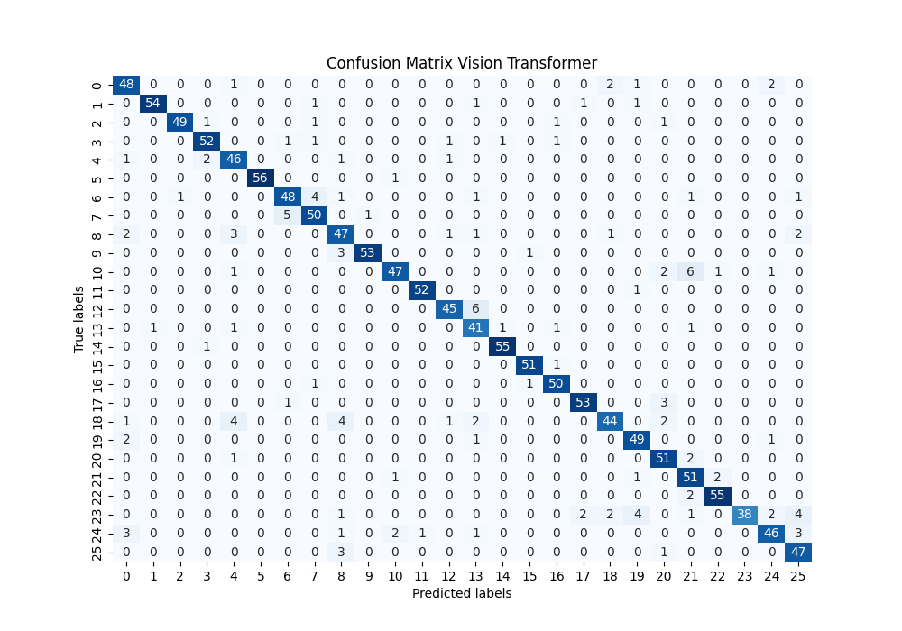
Vision Transformer on new Dataset – Confusion Matrix

Slide 28
Vision Transformer on new Dataset – Lost and Accuracy

Slide 29
Vision Transformer on new Dataset – Saliency Maps

Slide 30
AlexNet Model_3
Test Accuracy: 0.9360
Test Accuracy: 0.9360
Precision: 0.9387
Recall: 0.9360
F1-Score: 0.9359
Labels Testdaten: [17, 18, 14, 10, 18, 2, 22, 13, 17, 18, 15, 8, 4, 12, 2, 24, 9, 23, 20, 8, 23, 6, 19, 20, 8, 19, 14, 4, 13, 15, 14, 25, 13, 21, 21, 15, 25, 1, 17, 0, 20, 1, 9, 4, 8, 5, 17, 4, 22, 0, 17, 4, 15, 21, 18, 10, 9, 21, 17, 20, 14, 13, 14, 16, 16, 10, 24, 18, 4, 5, 21, 12, 12, 17, 9, 12, 13, 9, 9, 18, 13, 12, 23, 6, 13, 17, 5, 7, 16, 19, 16, 10, 6, 8, 9, 14, 5, 3, 23, 11, 18, 9, 12, 15, 25, 16, 15, 1, 25, 2, 4, 8, 13, 9, 1, 20, 7, 22, 22, 7, 0, 24, 7, 8, 24, 24, 21, 1, 7, 17, 9, 17, 14, 1, 22, 25, 8, 9, 4, 23, 5, 20, 11, 14, 15, 22, 22, 11, 17, 25, 23, 6, 10, 13, 24, 1, 16, 9, 7, 0, 0, 3, 5, 11, 21, 13, 2, 10, 0, 20, 21, 21, 8, 12, 24, 20, 8, 24, 6, 12, 8, 23, 3, 24, 2, 13, 1, 23, 24, 9, 14, 21, 1, 23, 22, 21, 11, 22, 22, 3, 16, 18, 16, 6, 8, 6, 9, 9, 20, 14, 20, 5, 19, 8, 13, 14, 3, 19, 11, 21, 9, 24, 20, 8, 14, 14, 15, 0, 7, 6, 8, 9, 1, 8, 2, 11, 17, 20, 17, 15, 2, 18, 1, 0, 7, 11, 2, 11, 9, 9, 4, 12, 10, 23, 12, 21, 19, 17, 2, 20, 6, 23, 3, 12, 0, 20, 24, 16, 22, 15, 20, 17, 23, 4, 13, 14, 13, 25, 11, 2, 3, 4, 20, 7, 18, 5, 5, 13, 13, 8, 17, 8, 6, 21, 22, 11, 1, 4, 9, 3, 3, 13, 21, 7, 11, 9, 24, 6, 23, 22, 2, 7, 0, 0, 4, 5, 6, 25, 0, 21, 23, 20, 12, 25, 6, 14, 20, 3, 24, 10, 19, 16, 14, 7, 10, 21, 20, 12, 11, 8, 4, 17, 0, 17, 11, 19, 5, 6, 17, 10, 24, 25, 15, 19, 5, 1, 0, 1, 2, 15, 22, 3, 1, 13, 12, 20, 1, 15, 6, 17, 24, 0, 21, 2, 3, 1, 2, 1, 18, 3, 8, 17, 18, 2, 11, 20, 11, 5, 23, 4, 3, 11, 8, 21, 9, 14, 11, 6, 25, 11, 12, 19, 14, 17, 6, 14, 25, 14, 8, 6, 23, 4, 24, 4, 4, 7, 7, 0, 8, 19, 24, 20, 22, 19, 20, 11, 21, 7, 20, 23, 24, 19, 15, 4, 21, 13, 3, 25, 13, 22, 2, 7, 11, 19, 5, 17, 20, 11, 18, 19, 23, 1, 3, 21, 4, 19, 12, 18, 19, 22, 6, 7, 11, 13, 9, 0, 19, 17, 25, 9, 9, 9, 0, 3, 4, 23, 1, 14, 1, 5, 15, 8, 7, 6, 12, 3, 20, 7, 1, 5, 23, 24, 14, 11, 9, 22, 12, 3, 20, 12, 22, 25, 1, 2, 10, 10, 22, 14, 17, 6, 24, 19, 8, 23, 0, 24, 19, 5, 7, 16, 9, 22, 10, 8, 5, 15, 22, 13, 14, 2, 19, 11, 12, 18, 16, 15, 19, 0, 20, 0, 2, 5, 17, 13, 3, 2, 18, 18, 4, 16, 8, 15, 8, 21, 7, 22, 25, 6, 18, 11, 13, 12, 16, 5, 20, 5, 1, 1, 11, 14, 6, 10, 20, 7, 6, 18, 25, 0, 10, 6, 11, 1, 6, 1, 12, 25, 25, 0, 19, 1, 2, 25, 22, 10, 12, 22, 22, 25, 10, 16, 15, 12, 11, 12, 12, 18, 10, 7, 16, 22, 18, 20, 9, 20, 19, 11, 18, 25, 24, 12, 8, 10, 5, 23, 2, 3, 17, 4, 21, 4, 7, 10, 17, 14, 16, 0, 10, 6, 8, 12, 25, 0, 15, 3, 19, 5, 15, 21, 16, 1, 24, 14, 11, 3, 20, 0, 3, 4, 14, 24, 9, 6, 5, 7, 13, 0, 6, 6, 23, 9, 19, 14, 25, 10, 21, 20, 1, 16, 0, 22, 14, 7, 3, 16, 6, 21, 1, 19, 22, 2, 7, 14, 25, 25, 17, 0, 9, 23, 5, 3, 21, 23, 17, 11, 1, 24, 11, 7, 19, 0, 25, 2, 4, 15, 18, 19, 19, 22, 11, 5, 16, 21, 18, 2, 3, 14, 10, 7, 6, 3, 16, 17, 3, 12, 21, 10, 15, 1, 17, 0, 15, 16, 8, 18, 17, 14, 3, 22, 10, 24, 1, 6, 14, 24, 18, 22, 23, 19, 18, 0, 16, 3, 5, 1, 24, 21, 10, 18, 7, 10, 21, 21, 18, 22, 0, 5, 18, 5, 4, 21, 13, 6, 22, 4, 20, 18, 10, 8, 22, 25, 17, 21, 5, 8, 16, 15, 6, 8, 10, 2, 23, 12, 0, 16, 18, 24, 25, 23, 18, 6, 8, 2, 0, 20, 2, 11, 20, 24, 22, 14, 21, 17, 13, 20, 22, 1, 9, 10, 8, 21, 14, 23, 13, 0, 9, 3, 8, 12, 0, 17, 16, 15, 24, 3, 16, 0, 3, 6, 23, 11, 12, 10, 23, 10, 2, 5, 16, 11, 25, 19, 14, 1, 19, 12, 20, 17, 1, 10, 7, 8, 4, 18, 2, 16, 9, 20, 5, 25, 22, 2, 2, 13, 23, 15, 14, 11, 10, 15, 23, 15, 22, 17, 11, 18, 25, 19, 4, 15, 22, 20, 6, 18, 13, 16, 2, 8, 25, 3, 5, 14, 1, 18, 21, 6, 17, 22, 23, 0, 4, 3, 15, 16, 10, 24, 0, 12, 17, 9, 14, 19, 8, 24, 14, 11, 20, 6, 1, 9, 4, 22, 18, 8, 16, 1, 17, 12, 18, 5, 22, 8, 16, 8, 25, 15, 11, 15, 18, 6, 13, 14, 4, 18, 9, 9, 5, 25, 21, 13, 15, 8, 19, 25, 15, 2, 1, 22, 23, 5, 9, 7, 24, 10, 3, 14, 25, 24, 10, 19, 24, 10, 3, 19, 25, 25, 16, 19, 5, 4, 21, 3, 0, 11, 24, 2, 23, 3, 17, 14, 21, 25, 13, 12, 13, 23, 12, 4, 15, 16, 9, 10, 4, 19, 24, 14, 10, 3, 21, 12, 12, 10, 5, 5, 10, 1, 23, 14, 10, 11, 18, 4, 21, 18, 25, 3, 21, 0, 19, 23, 22, 8, 21, 2, 20, 6, 24, 9, 17, 3, 15, 21, 16, 3, 2, 8, 10, 7, 13, 19, 6, 11, 22, 21, 25, 14, 12, 17, 7, 19, 8, 7, 7, 6, 5, 0, 10, 20, 19, 1, 23, 15, 24, 25, 13, 0, 5, 16, 10, 10, 1, 7, 22, 1, 18, 24, 15, 17, 3, 8, 8, 7, 18, 18, 16, 3, 2, 24, 4, 7, 12, 22, 4, 3, 4, 1, 24, 15, 21, 20, 17, 6, 20, 15, 9, 21, 11, 4, 23, 12, 18, 13, 9, 5, 6, 9, 7, 3, 16, 9, 2, 5, 23, 23, 12, 9, 8, 16, 16, 5, 1, 10, 14, 5, 11, 20, 7, 2, 22, 18, 11, 1, 25, 2, 12, 4, 3, 18, 15, 3, 2, 6, 13, 22, 17, 25, 5, 18, 10, 1, 13, 24, 12, 18, 5, 4, 3, 20, 7, 8, 7, 13, 2, 1, 7, 6, 17, 1, 4, 6, 19, 12, 17, 5, 14, 14, 15, 7, 16, 8, 15, 21, 2, 17, 4, 5, 20, 7, 19, 10, 3, 7, 2, 19, 0, 19, 9, 24, 25, 9, 17, 4, 17, 15, 0, 16, 23, 21, 6, 20, 16, 5, 6, 22, 4, 0, 16, 14, 2, 11, 7, 7, 21, 15, 16, 10, 12, 17, 24, 13, 18, 25, 7, 6, 20, 22, 23, 20, 4, 6, 24, 21, 17, 24, 24, 6, 22, 9, 8, 6, 14, 22, 2, 12, 1, 10, 13, 3, 22, 9, 8, 15, 23, 7, 2, 14, 9, 10, 21, 5, 25, 3, 6, 1, 23, 2, 15, 24, 0, 0, 17, 14, 21, 23, 7, 23, 7, 22, 7, 8, 8, 19, 1, 13, 23, 7, 17, 14, 17, 0, 10, 23, 0, 13, 10, 18, 3, 1, 2, 5, 4, 1, 15, 9, 5, 5, 5, 18, 2, 9, 15, 7, 22, 11, 16, 0, 10, 15, 0, 16, 13, 15, 18, 24, 24, 9, 10, 25, 24, 3, 12, 23, 4, 12, 18, 13, 3, 9, 6, 5, 9, 20, 0, 14, 24, 18, 25, 23, 16, 20, 8, 2, 11, 4, 19, 23, 19, 11, 1, 24, 16, 25, 19, 11, 10, 19, 5, 2, 12, 16, 11, 18, 24]
vorhergesagte Testdaten: [17, 18, 14, 10, 18, 2, 22, 13, 17, 18, 15, 8, 4, 13, 2, 24, 9, 23, 20, 8, 23, 6, 19, 20, 9, 19, 14, 4, 12, 15, 14, 18, 13, 21, 21, 15, 25, 1, 17, 0, 20, 1, 9, 4, 8, 5, 3, 4, 22, 0, 17, 4, 15, 21, 18, 10, 9, 21, 17, 20, 14, 13, 14, 16, 16, 10, 24, 18, 4, 5, 21, 12, 12, 17, 9, 12, 13, 9, 9, 8, 13, 13, 21, 6, 13, 17, 5, 23, 16, 19, 16, 10, 6, 8, 9, 14, 5, 3, 9, 11, 18, 9, 12, 15, 25, 16, 15, 1, 25, 2, 4, 8, 13, 9, 1, 20, 7, 22, 22, 7, 0, 24, 7, 8, 24, 24, 20, 1, 7, 17, 9, 17, 14, 1, 22, 25, 8, 9, 4, 23, 5, 20, 11, 14, 15, 22, 22, 11, 17, 25, 20, 6, 10, 18, 24, 1, 16, 9, 7, 0, 0, 3, 5, 11, 21, 13, 3, 10, 0, 20, 21, 21, 8, 12, 24, 20, 8, 24, 6, 8, 8, 23, 3, 24, 2, 13, 1, 23, 24, 3, 14, 21, 1, 23, 22, 21, 11, 22, 22, 3, 16, 23, 16, 6, 8, 6, 9, 9, 20, 14, 20, 5, 19, 1, 13, 14, 3, 19, 23, 21, 9, 24, 20, 8, 14, 14, 15, 0, 25, 9, 8, 9, 1, 8, 2, 11, 17, 20, 17, 15, 2, 18, 1, 0, 7, 11, 2, 11, 9, 9, 4, 13, 10, 23, 0, 21, 19, 17, 2, 20, 6, 23, 3, 13, 0, 20, 24, 16, 22, 15, 20, 17, 23, 4, 18, 14, 13, 25, 11, 2, 3, 4, 20, 7, 18, 5, 5, 13, 13, 8, 17, 8, 6, 21, 22, 11, 1, 4, 9, 3, 3, 13, 21, 7, 11, 9, 24, 6, 23, 22, 2, 7, 0, 0, 4, 5, 6, 25, 0, 21, 23, 20, 13, 25, 3, 14, 20, 3, 24, 10, 19, 16, 14, 7, 10, 21, 20, 12, 11, 8, 4, 17, 0, 17, 11, 19, 5, 4, 17, 21, 24, 25, 15, 19, 5, 1, 0, 1, 2, 15, 22, 3, 1, 13, 12, 20, 1, 16, 6, 17, 24, 0, 21, 2, 3, 1, 2, 1, 18, 3, 8, 17, 18, 2, 11, 20, 11, 5, 23, 3, 3, 11, 8, 21, 9, 14, 11, 6, 25, 11, 12, 19, 14, 17, 6, 14, 25, 14, 8, 6, 23, 4, 24, 4, 4, 3, 7, 0, 8, 19, 24, 20, 22, 19, 20, 11, 21, 7, 20, 23, 24, 19, 15, 4, 22, 13, 3, 25, 13, 22, 2, 7, 11, 19, 5, 17, 20, 11, 18, 19, 23, 1, 3, 21, 4, 19, 13, 18, 19, 22, 8, 7, 11, 13, 9, 0, 19, 17, 25, 9, 9, 9, 0, 3, 4, 23, 1, 14, 1, 5, 15, 8, 7, 6, 12, 3, 20, 7, 1, 5, 23, 24, 14, 11, 9, 22, 13, 3, 20, 13, 21, 25, 1, 2, 21, 10, 22, 14, 17, 6, 24, 19, 8, 23, 0, 24, 19, 5, 7, 16, 9, 22, 10, 8, 5, 15, 22, 13, 14, 2, 13, 11, 12, 18, 16, 15, 19, 0, 20, 0, 2, 5, 17, 19, 3, 2, 18, 18, 4, 16, 8, 15, 8, 21, 2, 22, 25, 6, 18, 11, 13, 12, 16, 5, 20, 5, 1, 1, 11, 14, 6, 10, 20, 7, 6, 23, 25, 0, 10, 6, 11, 1, 6, 1, 13, 25, 25, 0, 19, 21, 2, 25, 22, 10, 12, 22, 22, 25, 10, 16, 15, 12, 11, 12, 12, 18, 10, 7, 16, 21, 18, 20, 9, 20, 19, 11, 18, 25, 24, 4, 23, 10, 5, 23, 2, 3, 20, 4, 21, 4, 7, 10, 17, 14, 16, 0, 10, 6, 8, 12, 25, 0, 15, 3, 19, 5, 15, 21, 16, 4, 24, 14, 11, 3, 20, 0, 3, 4, 14, 24, 9, 7, 5, 7, 13, 24, 6, 6, 23, 9, 19, 14, 25, 10, 21, 20, 1, 16, 0, 22, 14, 7, 3, 16, 6, 21, 1, 19, 22, 2, 7, 14, 25, 12, 17, 0, 9, 23, 5, 3, 21, 23, 17, 11, 1, 24, 11, 7, 19, 18, 25, 5, 12, 15, 18, 19, 19, 22, 11, 5, 16, 21, 18, 2, 3, 14, 10, 7, 6, 3, 16, 25, 3, 12, 21, 10, 15, 1, 20, 0, 15, 15, 9, 8, 17, 14, 3, 22, 10, 24, 1, 6, 14, 24, 18, 22, 23, 19, 18, 18, 16, 3, 5, 1, 24, 21, 10, 18, 7, 21, 21, 21, 18, 22, 0, 5, 18, 5, 4, 21, 13, 6, 22, 4, 20, 18, 12, 8, 22, 25, 17, 21, 5, 8, 16, 15, 6, 8, 10, 2, 23, 12, 0, 16, 18, 24, 25, 23, 18, 6, 8, 2, 0, 20, 2, 11, 20, 12, 22, 14, 21, 17, 13, 20, 22, 1, 9, 10, 8, 21, 14, 21, 13, 0, 9, 3, 8, 12, 0, 17, 16, 15, 24, 3, 16, 24, 3, 6, 23, 11, 0, 10, 23, 10, 2, 5, 16, 24, 25, 19, 14, 1, 19, 12, 20, 17, 1, 10, 7, 8, 4, 18, 2, 16, 9, 20, 5, 25, 22, 2, 2, 13, 23, 15, 14, 11, 21, 15, 23, 15, 22, 17, 11, 18, 25, 19, 4, 15, 22, 20, 6, 18, 13, 16, 2, 8, 25, 3, 5, 14, 1, 18, 21, 6, 17, 22, 23, 0, 4, 3, 15, 16, 10, 24, 0, 12, 17, 9, 14, 19, 8, 24, 14, 11, 20, 6, 1, 9, 4, 22, 18, 8, 16, 1, 17, 12, 18, 5, 22, 8, 16, 8, 25, 15, 11, 15, 18, 6, 13, 14, 4, 18, 9, 9, 5, 25, 21, 3, 15, 9, 19, 25, 15, 2, 1, 22, 23, 5, 9, 7, 24, 10, 3, 14, 25, 24, 10, 19, 12, 10, 3, 19, 25, 25, 16, 19, 5, 4, 21, 3, 0, 11, 24, 2, 23, 3, 17, 14, 21, 25, 13, 12, 13, 23, 12, 4, 15, 16, 9, 10, 4, 19, 24, 14, 10, 3, 21, 13, 12, 10, 5, 5, 20, 1, 23, 14, 10, 11, 18, 4, 21, 18, 25, 3, 21, 0, 19, 23, 22, 8, 21, 2, 20, 6, 24, 9, 17, 3, 16, 21, 16, 3, 2, 8, 10, 7, 13, 19, 6, 11, 22, 21, 25, 14, 12, 17, 7, 19, 8, 7, 7, 6, 5, 18, 10, 20, 19, 1, 23, 15, 24, 25, 13, 0, 5, 16, 10, 21, 4, 7, 22, 1, 18, 24, 15, 17, 17, 8, 8, 7, 18, 18, 16, 3, 2, 24, 4, 7, 13, 22, 4, 3, 3, 1, 24, 15, 21, 20, 17, 6, 20, 15, 9, 21, 11, 4, 23, 12, 18, 13, 9, 5, 6, 9, 7, 3, 16, 9, 2, 5, 23, 23, 12, 9, 8, 16, 16, 5, 1, 10, 14, 5, 11, 20, 7, 2, 22, 18, 11, 1, 25, 2, 12, 4, 3, 18, 15, 3, 2, 6, 13, 22, 17, 25, 5, 18, 10, 1, 13, 24, 13, 18, 5, 4, 3, 20, 7, 8, 7, 13, 2, 1, 7, 6, 25, 1, 0, 6, 19, 12, 17, 5, 14, 14, 15, 7, 16, 8, 15, 21, 2, 17, 4, 5, 20, 7, 19, 10, 3, 7, 2, 19, 0, 19, 9, 24, 25, 9, 17, 4, 17, 15, 0, 16, 23, 21, 6, 23, 16, 5, 6, 22, 4, 0, 16, 14, 2, 11, 7, 7, 21, 15, 16, 10, 12, 17, 24, 13, 18, 25, 7, 6, 20, 22, 23, 20, 4, 6, 24, 21, 17, 24, 24, 6, 22, 9, 8, 6, 14, 22, 2, 12, 1, 10, 13, 3, 22, 9, 8, 15, 23, 7, 3, 14, 9, 10, 21, 5, 25, 3, 6, 1, 23, 2, 15, 24, 0, 0, 17, 14, 21, 23, 7, 23, 7, 22, 7, 8, 8, 19, 1, 13, 23, 7, 17, 14, 17, 0, 10, 23, 0, 13, 10, 18, 3, 1, 2, 5, 4, 1, 15, 9, 5, 5, 5, 18, 2, 9, 15, 7, 22, 11, 16, 0, 10, 15, 0, 16, 13, 15, 18, 24, 24, 9, 10, 25, 24, 3, 12, 23, 4, 12, 18, 13, 23, 9, 6, 5, 9, 20, 0, 14, 24, 18, 25, 23, 16, 20, 8, 2, 11, 4, 19, 23, 19, 11, 1, 4, 16, 25, 19, 11, 10, 19, 5, 2, 13, 16, 11, 18, 25]

Slide 31
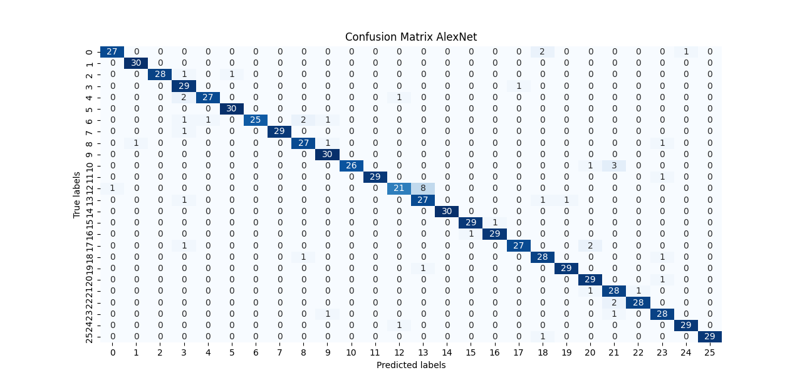
AlexNet dataset 2 model 3

Slide 32
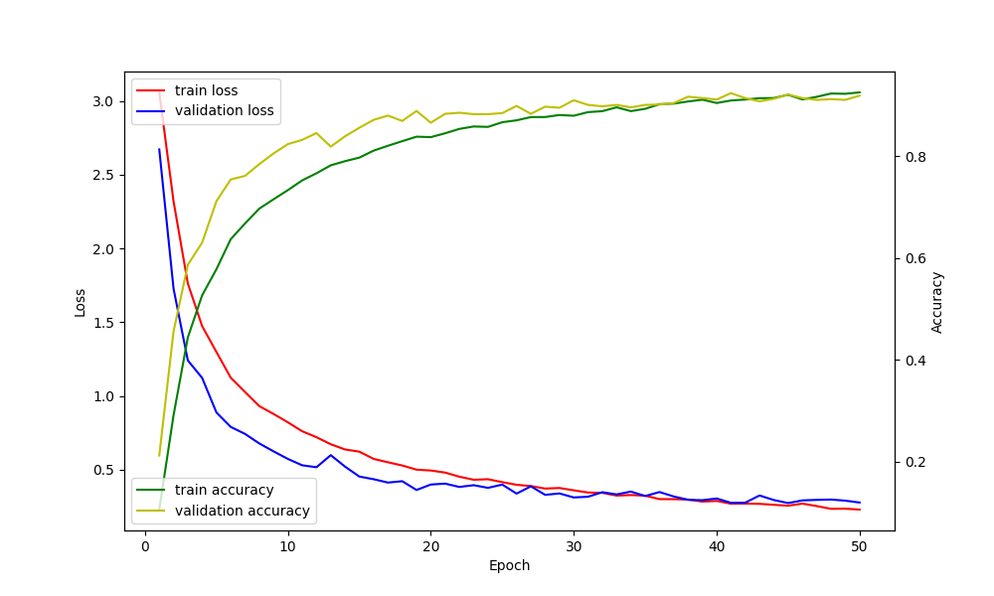
AlexNet dataset 2 model 3

Slide 33
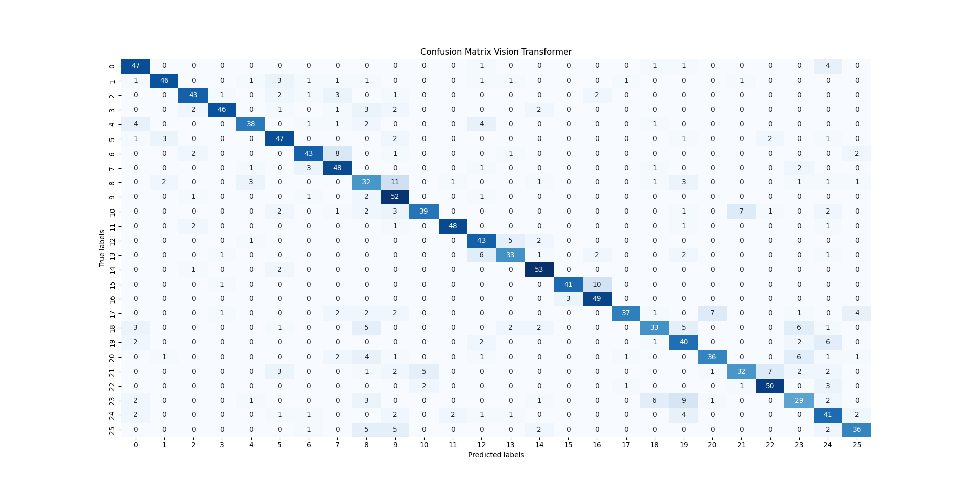
ViT dataset 2 model 7

Slide 34
Neue Überlegung
Vision Transformer ist ein Modell, dass Bilddaten 1000+ pro Klasse erwartet
Die Bilder in unserem Datensatz sind sich sehr ähnlich, deshalb zuvor 400 Bilder pro Klasse
Nun Test, ob die Accuracy und die Generalisierung der Klassifikation besser wird, wenn 1000 Bilder pro Klasse vorhanden sind: Neuer Datensatz 640 Bilder des Kaggle Datensatz + ca. 500 Bilder aus mediapipe

Slide 35
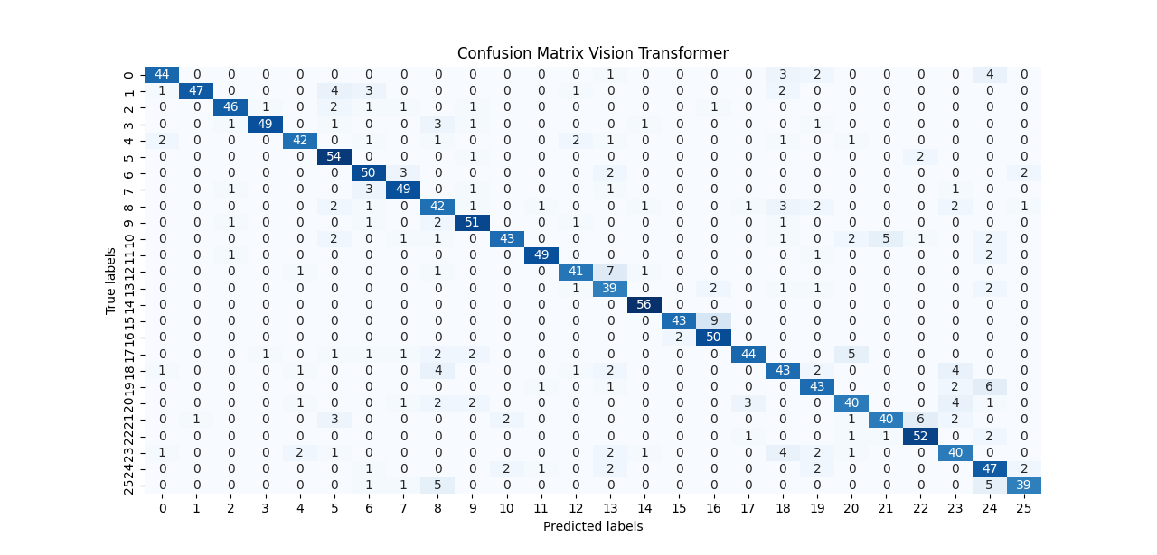
ViT dataset 2 model 8

Slide 36
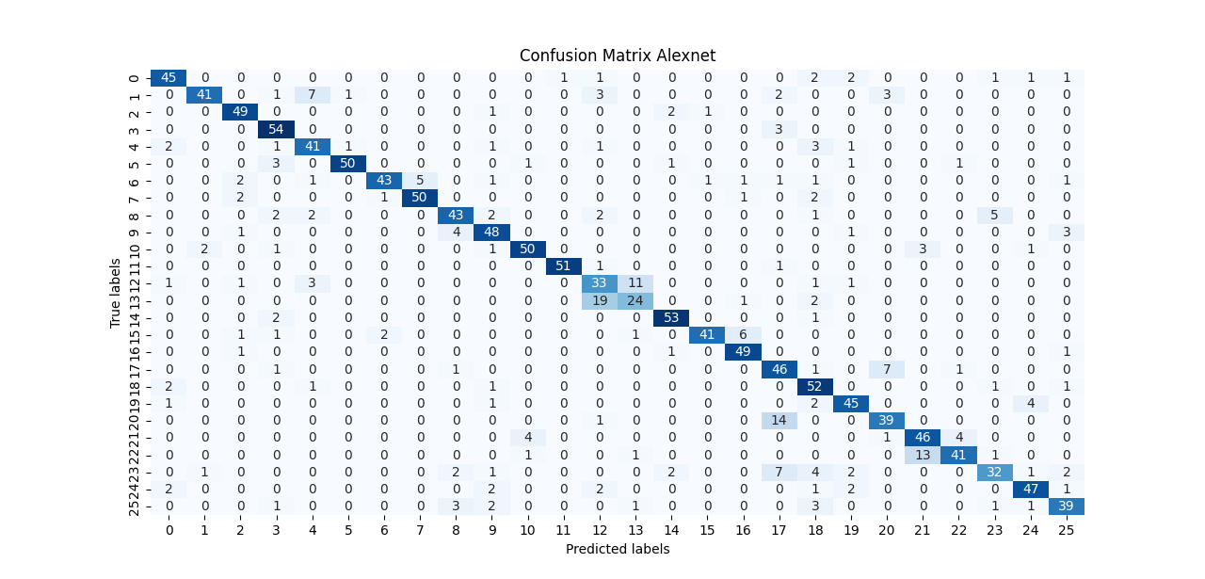
AlexNet dataset 3 (mehr daten)

Slide 37
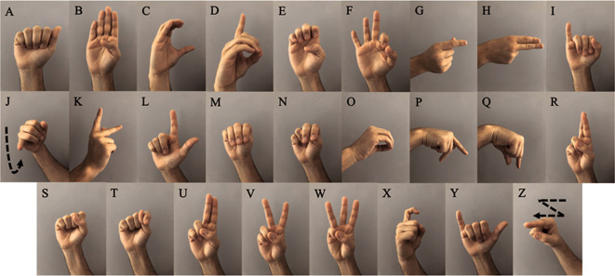
0 1 2 3 4 5 6 7 8
9 10 11 12 13 14 15 16 17
18 19 20 21 22 23 24 25

Slide 38
Zukunft
Diffusion Model verbessern
Die sehr änhlichen Buchstaben weitere Bilder hinzufügen bei denen die Unterschiede deutlicher werden

